Slide 1


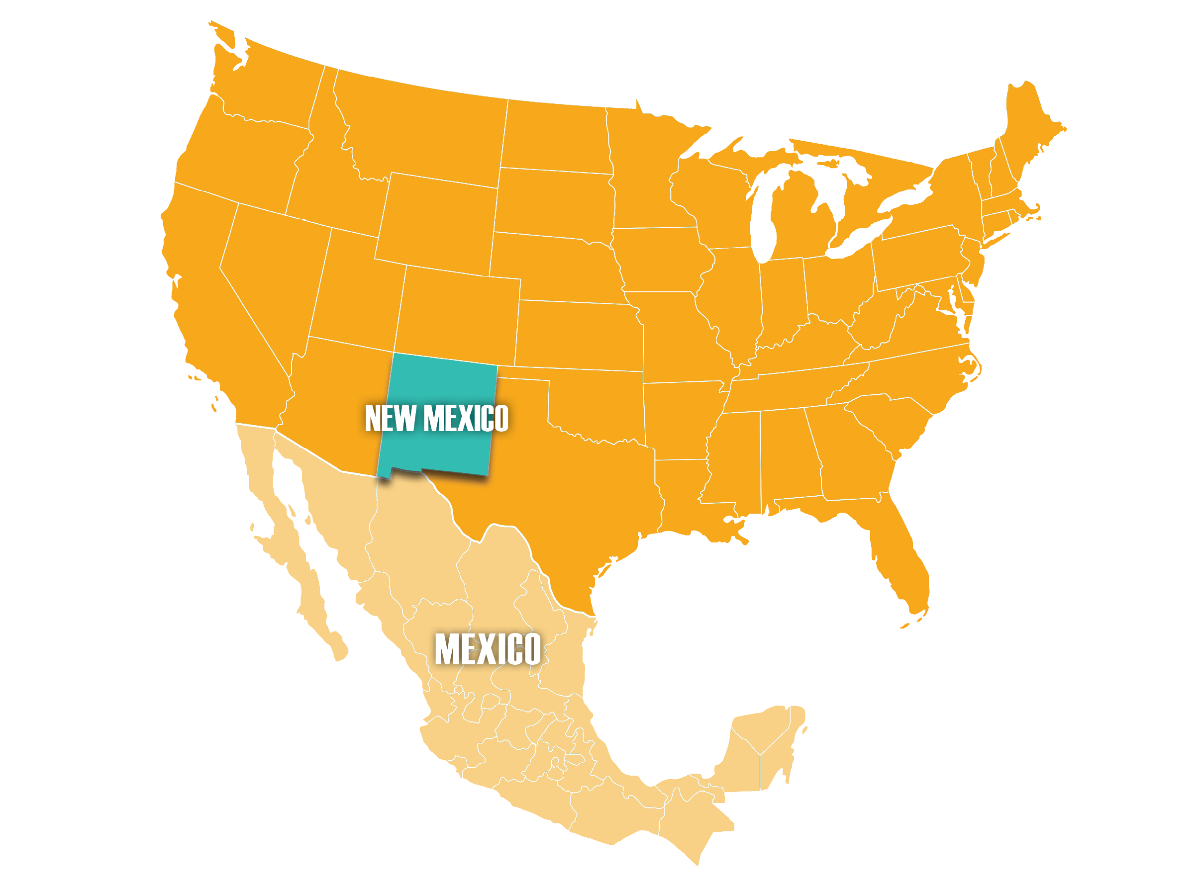

Electrification in New Mexico

Slide 2
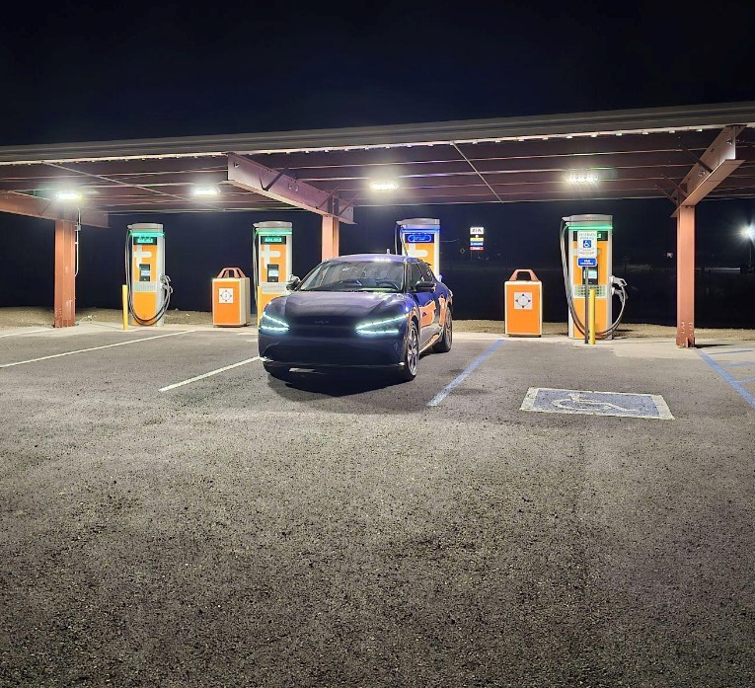
New Mexico Electric Vehicle Program Goals
Establish an electrified and alternative fuel transportation system.
Create a system that is convenient, affordable, reliable, equitable, accessible, and safe Establish a path for the U.S. to create a nationwide network of at least 500,000 EV chargers by 2030
Improve networks for vehicles using hydrogen, propane, and natural gas

Slide 3
New Mexico EV Infrastructure Project Funding Sources
2021 Infrastructure Investment and Jobs Act (IIJA)Apportionment: $38.3M
2021 Regular Legislative Session Capital Appropriation: $1.2M
2021 Special Session America Rescue Plan Act (ARPA): $10M
2024 Charging and Fueling Infrastructure (CFI) Grant: $67.7M
2024 Legislative Session Capital Appropriation:$15M

Slide 4
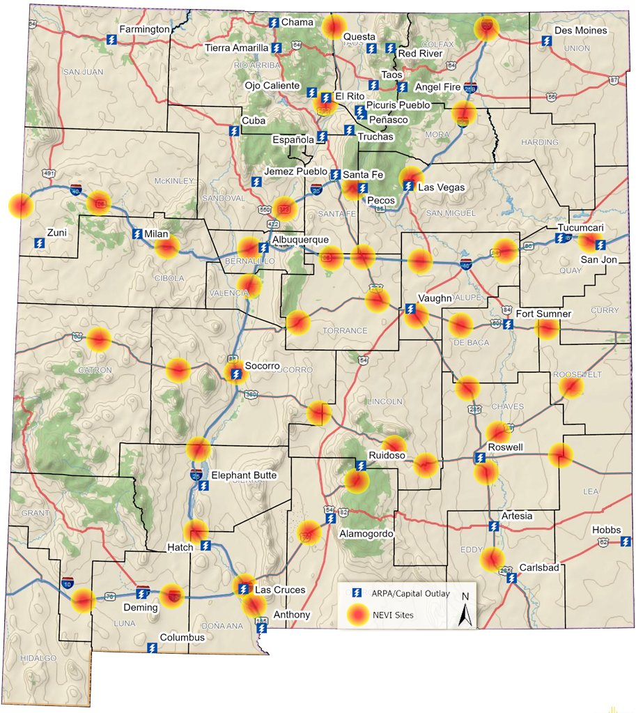
Electric Vehicle Infrastructure Projects
Provides drivers with a convenient, reliable, affordable, accessible, and equitable charging experience
Meet federal goals for statewide electrification network
Support economic development opportunities for rural parts of the state
Notes:
The funds will be used for the expansion of a National EV Charging Infrastructure network in the State of New Mexico.
In the first round of funding distributions, NMDOT received 17 applications and awarded $11.9 million to six (6) entities, for a total of 20 locations and 84 new EV chargers across New Mexico. Additional phases of funding distribution will be available in the Spring.
State of New Mexico American Rescue Plan Act (ARPA) Projects - $10M Allocation
Focus on rural and disadvantaged communities
Work with local governments to provide grant opportunities for funding public facing infrastructure
Meet current or anticipated market demands for charging or fueling infrastructure, including faster charging speeds with high-powered capabilities necessary to minimize the time to charge or refuel current and anticipated vehicles
(blue lightening bolts represenet ARPA locations)
The NEVI Plan for New Mexico aims to build-out major interstates including: I-25, I-40 and I-10.

Slide 5
Future Program Considerations
Unfunded gaps
Equity (Justice 40) and Disadvantage Community Participation
Supply chain issues around electric components – Build America, Buy America Act
Utility and Cooperative delays;14-month delay on transformers
Robust workforce for EV infrastructure installation and maintenance; and car technicians
Unknowns with competitive grants
Access to high-level grid for electrical connectivity
Statewide broadband connectivity for charge station network

Slide 6
Thank You!
  Jerry P. Valdez, Executive Director
  New Mexico Department of Transportation
  Jerry.Valdez@dot.nm.gov
  1-505-795-3033

