Slide 1
THE CASE FOR SITE READINESS
abq.org | live.abq.org | abqsites.com

Slide 2
2024 AREA BOARD OF DIRECTORS
Don Tarry, Chair of the Board
Phil Casaus
Joanie Griffin
Lori Anne McBride
Public Service Company of New Mexico (PNM)
BRYCON Corporation
Sunny505
Manpower
Jim Chynoweth
Debbie Harms
Meg Meister
Josh Parsons, Chair-Elect
CBRE Inc. Albuquerque
NAI SunVista
Modrall Sperling
Sandia National Laboratories
Kent Cravens
Tracy Hartzler
Central New Mexico Community College
Roxanna Meyers
Teresa Costantinidis, Treasure
Greater Albuquerque Association of Realtors
Century Sign Builders
University of New Mexico
Michelle Dearholt
Justin Horwitz
Celina Bussey, Secretary
Nusenda Credit Union
Rodey Law Firm
Adrian Montoya
Deloitte Consulting LLP
Robin Divine
Ruth Huning-Gonzales
Summit Electric Supply
Cynthia Schultz, Immediate Past Chair
TriCore Reference Laboratories
Huning, LLC
Ryan Shell
Bradbury Stamm Construction, Inc.
Joe Farr
Shad James
New Mexico Gas Company
Duke City Commercial, LLC
Jaynes Corporation
Ben Spencer
Danielle Casey, President & CEO
Titan Development
Albuquerque Regional Economic Alliance
Frank Gallegos
Wayne Johnson
Intel Corporation
Sandoval County
Joan Tafoya
Kyle Beasley
Caroline Garcia
Leean Kravitz
META
Bank of Albuquerque
KPMG LLP
Fidelity Investments
Janice Torrez
Walt Benson
Benjamin Gardner
Pepper Lang
Blue Cross Blue Shield of New Mexico
Bernalillo County
Dekker/Perich/Sabatini
Albuquerque Journal
Brian Brown
Eric Weinstein
Presbyterian Healthcare Services
Marcos Gonzalez
Adam Leyba
HUUB
Bernalillo County
Klinger Constructors, LLC
Mike Canfield
Troy Greer
Dan Long
Indian Pueblo Cultural Center
Lovelace Health System
Gridworks, Inc.

Slide 3
THANK YOU TO OUR CONTRIBUTORS!
DIAMOND
GOLD CONTRIBUTORS
Albuquerque Journal • Bank of Albuquerque • Blue Cross Blue Shield of NM • Bradbury Stamm Construction • COMCAST • ExxonMobil • FRENCH Funerals & Cremations • Gridworks • Heritage Real Estate Company • Huning, LLC • Intel • Jaynes Construction • NAI Sun Vista • New Mexico Gas Company Nusenda Credit Union • Presbyterian Health Services
Summit Electric Supply Co. • Titan Development
SILVER CONTRIBUTORS
Aon • Bohannan Huston • CBRE Inc. Albuquerque • Comcast • Dekker • Garrett Development Corporation
Klinger Constructors, LLC • KPMG LLP • Lovelace Health System • Maestas Development Group
Manpower of New Mexico • PNC Bank • Sandia National Laboratories • TriCore Reference Laboratories
BRONZE CONTRIBUTORS
Albuquerque Academy • Bank of the West • Century Sign Builders • Central New Mexico Community College (CNM) • Deloitte Consulting LLP • Delta Dental
Duke City Commercial LLC • FBT Architects • Greater Albuquerque Association of REALTORS® • HB Construction, Inc • Homewise • Hub International • JPMorganChase • Meta • Modrall Sperling Roehl Harris & Sisk, P.A. •Page / • Rodey Law Firm • Sunny505 • Terracon Albuquerque • UNM Health System
Verus Research • Wells Fargo Bank New Mexico, NA • Western Sky Community Care (Centene) • Yearout Mechanical, LLC
COMMUNITY PARTNERS
City of Albuquerque • Bernalillo County • Town of Edgewood • Village of Los Lunas
City of Rio Communities • Sandoval County
PLATINUM

Slide 4
Top Factors Influencing
Site Selection by Project Type
Notes:
CHAD:
Pipeline overview, and also how many we have already missed due to lack of site availability.

Slide 5
READY TO GO SITES ARE CRITICAL
Ready-to-go sites, buildings and faster permitting are also top reasons for companies relocating to other states.
2024 State of Site Selection
of Guild members strongly agree that for industrial projects, the availability of development-ready sites with sufficient infrastructure capacity is the top location driver in 2024.

Slide 6
SITE SELECTORS AGREE
The hyperactivity in industries such as electric vehicles, semiconductors, clean energy, and metals has severely depleted the inventory of quality mega sites.
Most of what is left would require lengthy and costly improvements for a large-scale user to become operational.
Lead times on transformers and other critical electrical equipment are ranging from 24 to 30 months.
This pushes large industrial projects to explore water treatment, recycling, and reuse on-site.

Slide 7
Per capita Sq. Ft. of Industrial Inventory
228
With minimal population growth, this figure popped after the delivery of the Amazon facility
150
140
116
108
100
94
89
87
72
71
66
66
59
55
48
Notes:
CHAD:
Pipeline overview, and also how many we have already missed due to lack of site availability.

Slide 8
Price per Square Foot - Industrial
YTD Q3 2024
$14.22
$13.67
$12.34
$11.79
$11.41
$10.96
$10.90
$10.84
$10.70
$10.43
$9.76
$9.19
$8.89
$8.29
$8.22
$6.95
Notes:
CHAD:
Pipeline overview, and also how many we have already missed due to lack of site availability.

Slide 9
Max/Mins of Key Site Criteria

Slide 10
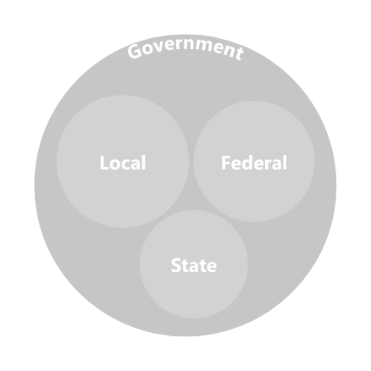
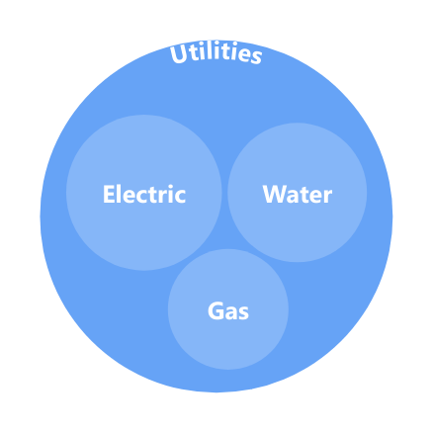
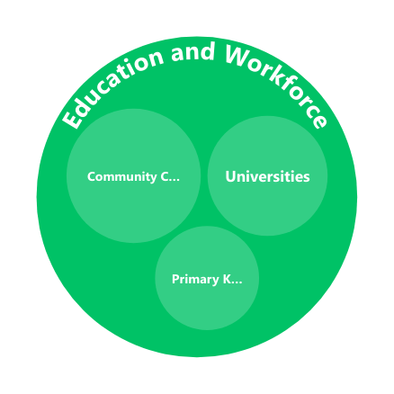
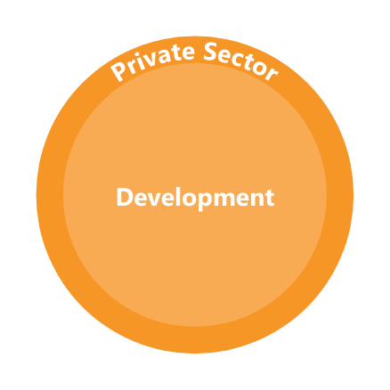
IT REQUIRES ALIGNMENT AMONG NUMEROUS ENTITIES

Slide 11
PROGRAM COMMONALITIES
Site Characterization
A process used to evaluate a sites current level of development readiness.
VIRGINIA- $126 MILLION
TENNESSEE - $65 MILLION
OHIO - $50 MILLION
Site Development Fund
Used to further develop site infrastructure, aligned to the previous characterization process.

Slide 12
VIRGINIA- $126 MILLION

Slide 13
TENNESSEE - $65 MILLION

Slide 14
OHIO - $50 MILLION

Slide 15
MICHIGAN- $87.5 MILLION
Speculative building project is identified by local partner and/or developer.
MEDC business development manager (BDM) for the region should be engaged. The BDM will conduct a preliminary review of the project plan. If the project requires further consideration of state incentives or financing assistance to move forward, the BDM will ask the developer to provide a project summary and complete the MEDC speculative building supplemental form.
The project will undergo an evaluation and consideration by MEDC to determine if incentives or financing are needed and if so, what tools would be most appropriate.
The BDM and business development project manager will proceed with appropriate follow up with the developer or local partner.
For projects seeking consideration for capital access financing only, the developer or qualified lending institution may work directly with the capital access team for project review and consideration

Slide 16
Nationwide Distribution
A representative sample of existing site readiness programs across the country.
Estimated count of states with some program at the state, regional, local, or utility level.

Slide 17
PROGRAM RESOURCE RECOMMENDATIONS:
Phase 1: State Level Funding of $100 million + & Enabling Legislation to Allow for Proactivity and Flexibility
This includes the expansion of a statewide inventory and assessment of the cost to develop property infrastructure to serve highest and best uses for target employment locations, and pre-development costs.
Phase 2: Financial Mechanism(s) to Fund Public Infrastructure: $500 million - $1 billion
Used to further develop site infrastructure, aligned to the previous characterization process.

Slide 18
FOR GREATER ALBUQUERQUE - AND NM - TO BE COMPETITIVE & ATTRACT NEW BUSINESS INVESTMENT, IT WILL REQUIRE ALL OF THE FOLLOWING THREE CRITICAL ELEMENTS:
Site Characterization Program & Predevelopment Funding
The Ability for Utilities to Operate & Deliver Proactively
Permitting: Transparency and Timeliness

Slide 19
AREA 2024 KEY INITIATIVES & TARGET OUTCOMES
REGIONAL & STATE BUSINESS BRAND
DOWNTOWN REVITALIZATION
TALENT AND WORKFORCE
SITE READINESS
Passage of Bill or Bills to Address Site Readiness Needs
BID planning process is complete, and if established has a private board & a professional executive director in place
Significant major investment is being advanced in the region with partnership of UNM, government entities, and others
Talent Advisory has executed on initiatives in AREA 1.0.
Comprehensive study has been funded and completed.
$200k Regional, $5 million statewide funding minimum
Campaign Execution over 24 months results in measurable positive perceptions of market, and increased activity for business expansions and talent attraction

Slide 20
Isleta Resort & Casino
September 25-26, 2024
Join us for this critical gathering of economic developers and community leaders from across New Mexico as we embark on a transformative journey towards a prosperous future. The Governor's Conference for Economic Development is back, and it promises to be an event of unparalleled significance.

Slide 21
Thank You
DANIELLE CASEY
PRESIDENT & CEO
DCASEY@ABQ.ORG

