Slide 1











LoCALmotion!
Rooted in Community. Powered by Movement.
Hugo P Siaudzionis
Vedant Acharya
Congduo(Flora) Xie
Amelia Richmond
SITE PLANNER
EQUITY DIRECTOR
FINANCIAL ANALYST
NEIGHBORHOOD LIAISON
Team:
CAL Students
Chunman Li
Zoë Meinke
Jeenus Shrestha
NEIGHBORHOOD LIAISON
ECO DIRECTOR
MARKETING DIRECTOR

Slide 2
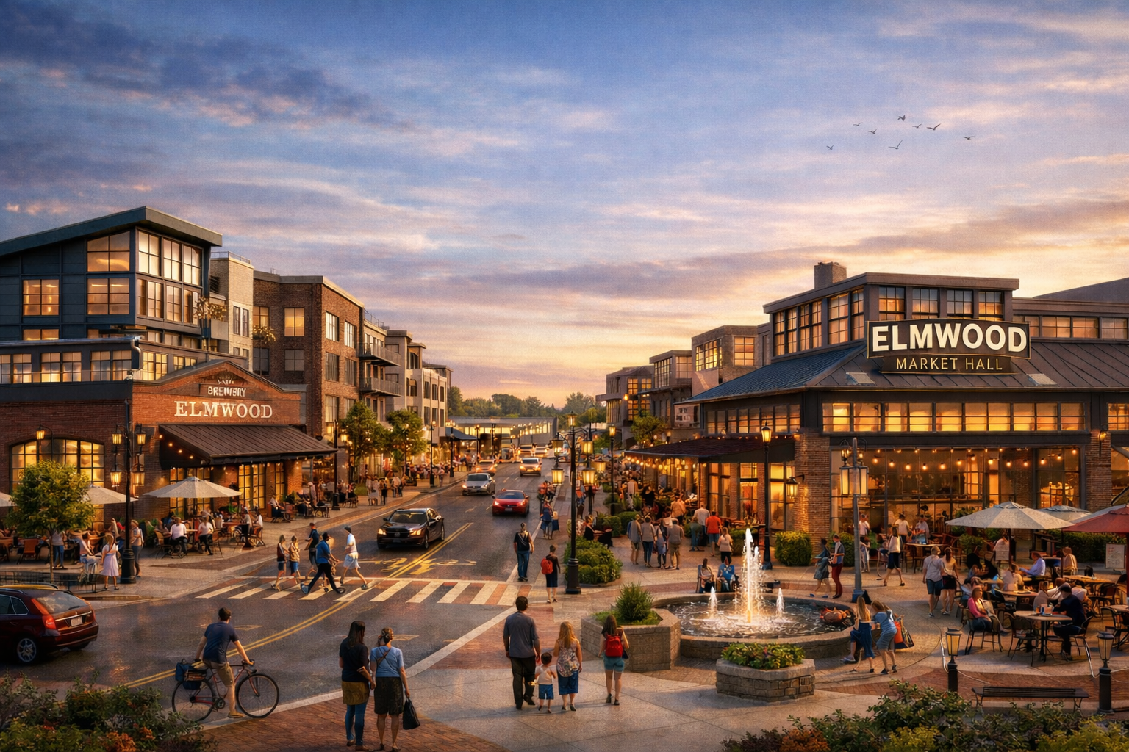
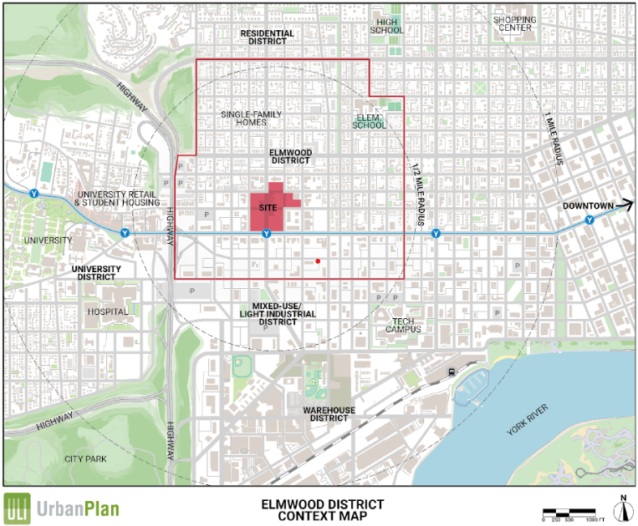
Elmwood reactivates its industrial past as a vibrant, walkable district of layered programs and varied massing along a legible main street spine. By restoring historic patterns of main street development and everyday movement, daily trips sustain local businesses, strengthen community, and build lasting economic resilience

Slide 3
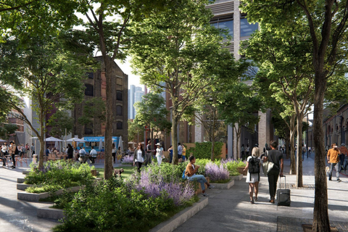
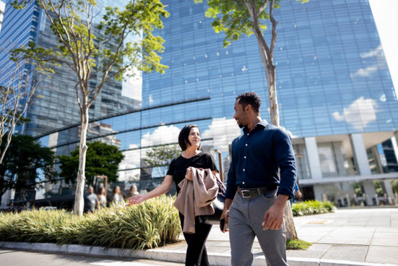
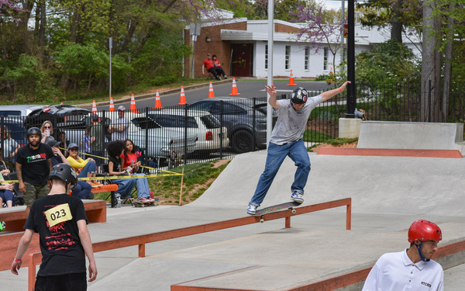
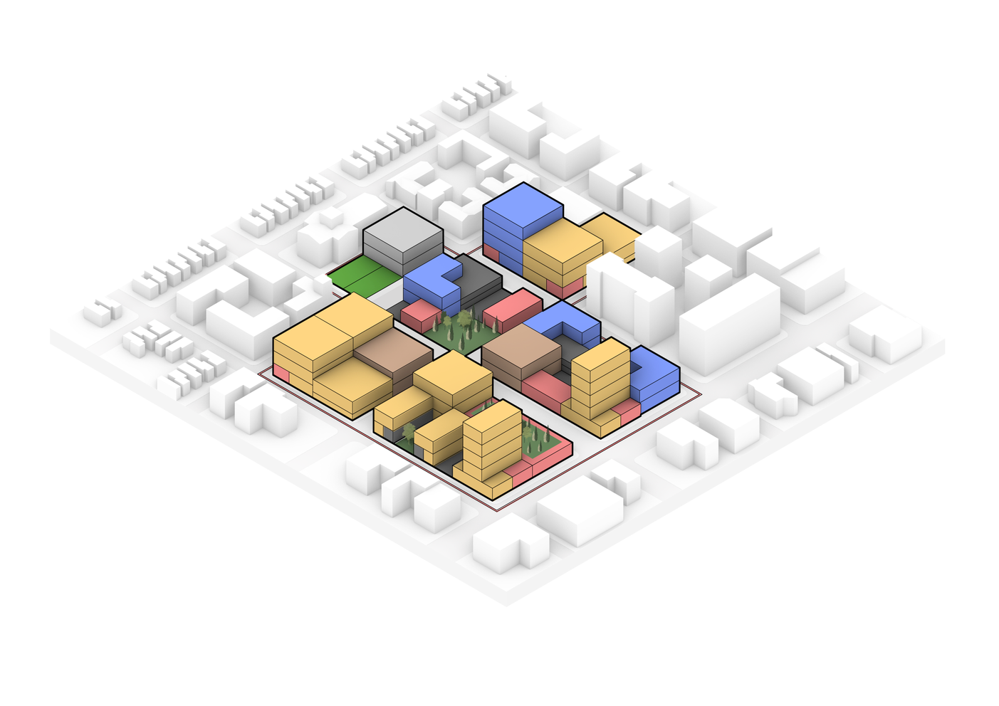
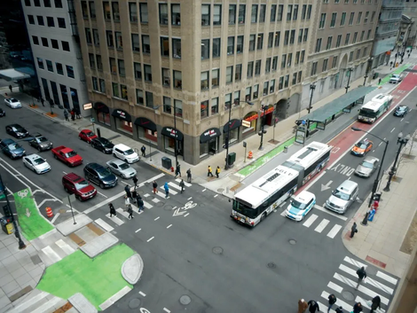
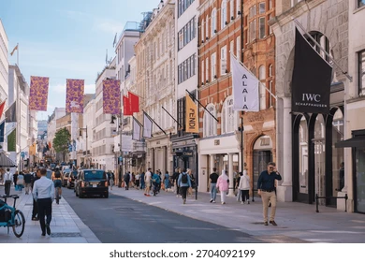

Guiding Principles
Vibrant & inclusive community
Creation of housing, jobs, and third spaces
Historic character & development patterns
Dispersed density for authentic placemaking
Retail-informed pedestrian flow
Retail capture to drive economic resilience
Our retail strategy is centered around creating a dynamic ecosystem that caters to the community's daily needs and fosters vibrant activity throughout the day and night.

Slide 4
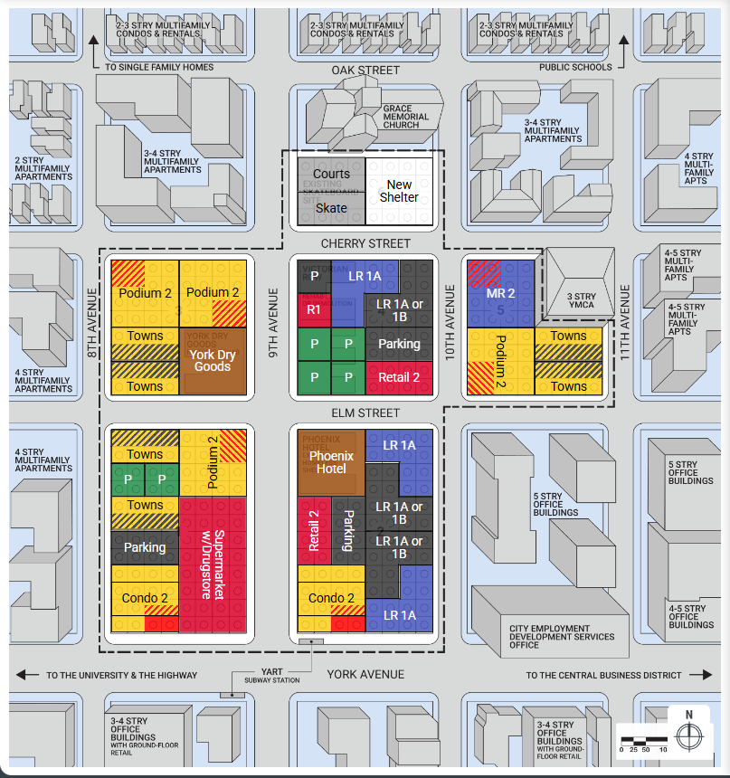



Site Plan
Vibrant & inclusive community:
  Active retail frames the central plaza
  9th Street activated as civic spine
Historic character:
  Phoenix Hotel and York Dry Goods reimagined as community anchors
  Historic development patterns of
mixed use & distributed density

Slide 5
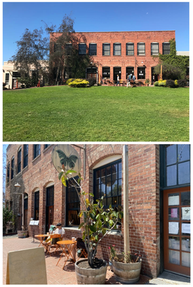
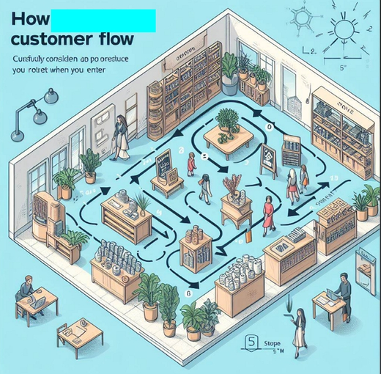



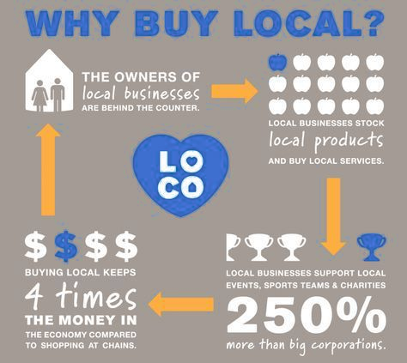

Designed for Resilience
  Circulation to capture local spending
  25,000 SF of new neighborhood retail
  Supported by 3:1 jobs-to-housing ratio
  Symbiotic park & cafe interface
  Local spending re-circulates, drives
economic resilience
Retail-informed pedestrian flow:

Slide 6
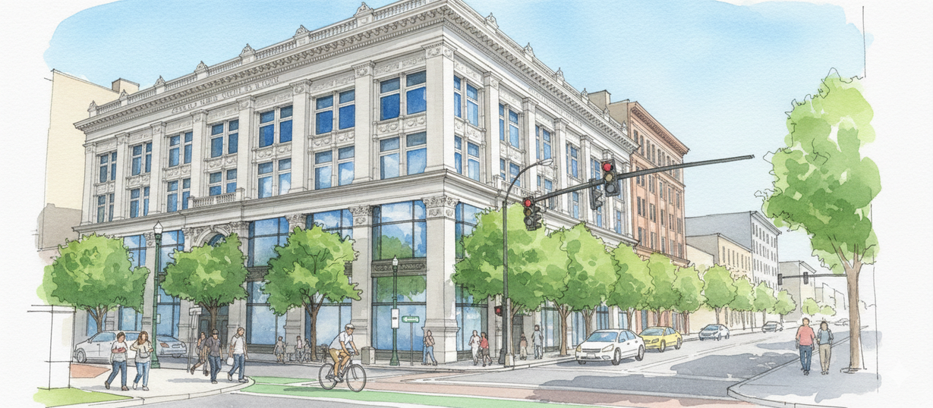
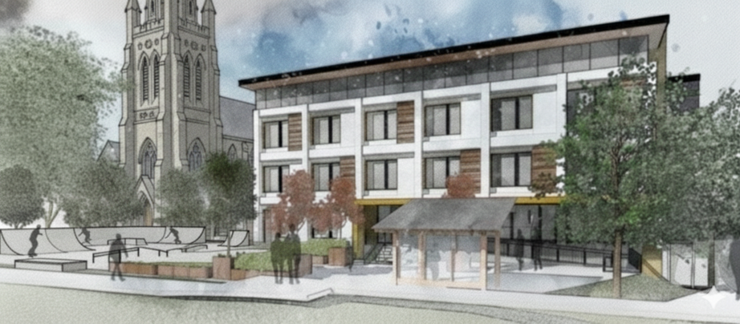
Revitalized Character & History
Extending the neighborhood character and history of Elmwood into this revitalized eco-friendly community.
Vibrant & inclusive community
Daily life & gathering places
Retail-informed pedestrian flow
Economic resilience
Historic character & development patterns
Preservation & identity
Renovated York Learning Center
Church Social Housing

Slide 7
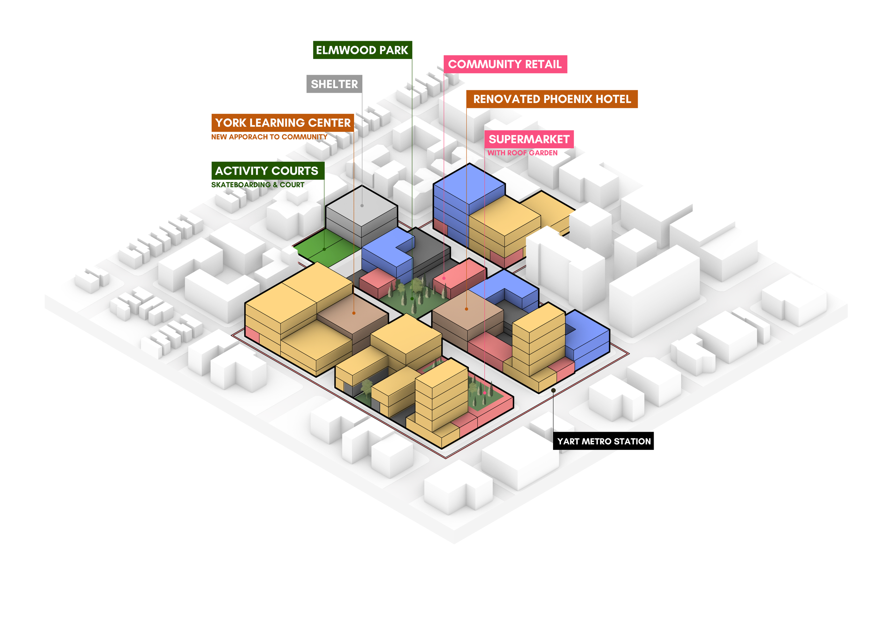













Embracing Community
Balancing cooperation within the community and achieving city goals
RENOVATED YORK DRY GOODS

Slide 8

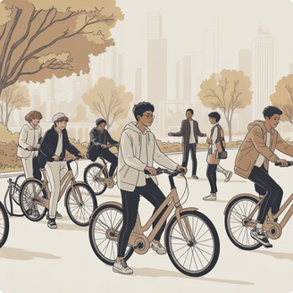
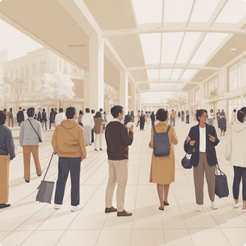
Community Impact
Empowering Seniors
Engaging Youth
Justice for Elmwood
Supporting aging-in-place through a dedicated 6,000 SF Senior Center and accessible, walkable retail options that enhance daily life and independence.
Providing a 5,500 SF Bike Share, 10,000 SF skate park, and courts offering safe and enriching activities for youth.
Committing to 11% Affordable Housing and creating entry-level retail jobs, fostering economic equity and opportunity within the community.

Slide 9
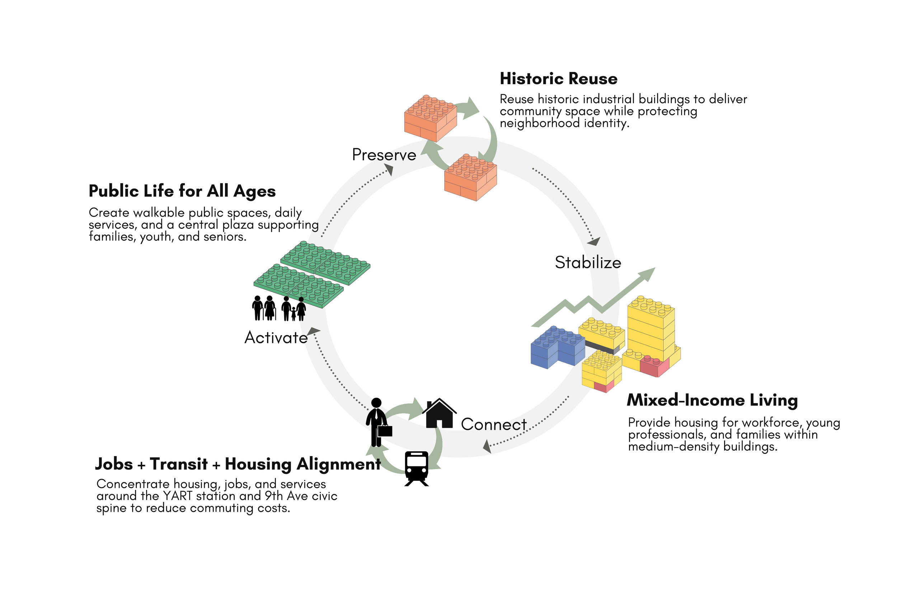
Equity Strategy

Slide 10
EcoDistrict Strategy
EcoDistrict Priorities | Pillars | Evidence
Vibrant & Inclusive Community | Equity & Resilience | 11% affordable housing Library & public health clinic Senior center & bike share hub Artist studios & small business incubator
Historic character & development patterns | Climate Protection & Equity | 35% net zero buildings Restoration of two historic buildings reduced embodied carbon
Retail-informed pedestrian flow | Climate Protection Equity & Resilience | Walkable, mixed use plan that fulfills all basic needs Transit-oriented, pedestrian-focused circulation

Slide 11









Dry Goods Community Facilities:
Financial Summary
13.6%
$9.88M
Rate of Return
City Revenue
11%
436
Affordable Housing
Housing Units
1,330
452
Jobs Created
FT Entry-Level Jobs
10%
35%
Open Space
Net Zero Buildings
Grocery Store
Shelter
Restored Buildings

Slide 12

Marketing Strategy
Residential
Office
Absorption Strategy
43
1.79%
135,000 SF
1.88%
Risk-adjusted return on condos
Business Incubator for small retail
Retail-informed pedestrian flow to increase retail spending & lease-up
Low-Rise Office
Townhomes
Absorption
Absorption
204
2.35%
120,000
1.71%
Mid-Rise Office
Apartments
Absorption
Absorption
112
3.20%
Condos
Retail
Absorption
25,000 SF
3.18%
Neighborhood Retail
Absorption
40,000
2.67%
Supermarket
Absorption

Slide 13
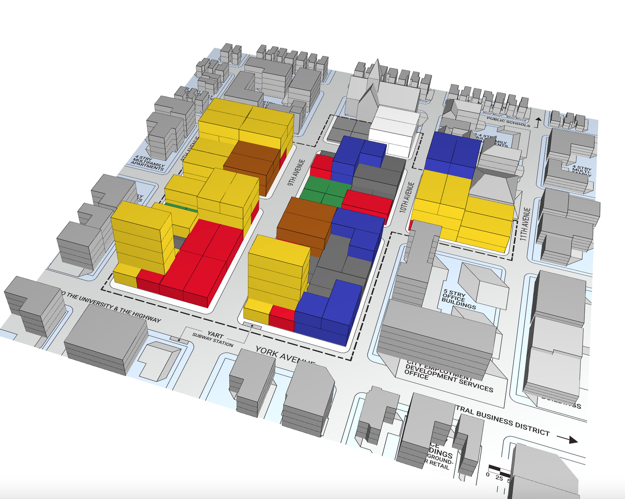

Thank You
Do the LoCALmotion!
Team:
CAL Students

Slide 14
Appendix

Slide 15
Community Impact
Exceeds city affordable housing mandate
41 low or very-low income housing units
714 Entry-level jobs
Affordable basic level retail goods and services
Public Health Clinic, Library
10K SF Rent Free in Rehabilitated York Dry Goods
No Q-Mart, but readily available neighborhood retail
Public health clinic and senior center
Calm street by Church
Business Incubator and Library in York Dry Goods, university extension site
Flexible life long learning and opportunity for small business support
10K SF Skate Park
Rehabilitated York Dry Goods and Phoenix Hotel
Quiet residential street near church at north, with human and neighborhood scale
Limited affordable housing
Church led social housing
Tall buildings and traffic primarily at south along York Ave.
5.5K SF for Yorktown Bike Share office
35% Net Zero buildings with future opportunities to improve
Supermarket with Green Roof
New Homeless Shelter | 120 beds

Slide 16
Outcome Metrics
Vibrant & inclusive community:
  50,000 SF open space (park/plaza, sports courts, skate park)
  Branch Library
  Public Health Clinic
  Senior Center
  Yorktown Bike Share
  Artist Studios
  35% Net Zero buildings

Slide 17
Outcome Metrics
Historic character & development patterns:
  Adaptive reuse of Phoenix Hotel
  Adaptive reuse of York Dry Goods
  Mixed-use & mixed-scale development
  Supermarket & neighborhood retail

Slide 18
Outcome Metrics
Economic resilience:
  $9.9M City Net Revenue
  13.6% Rate of Return
  1,330 jobs created across pay scales
  436 housing units created (3:1 jobs ratio)
  11% Affordable Housing (15% Very Low, 15% Low, 10% Moderate)
  Small Business Incubator

Slide 19
EcoDistrict Strategy
EcoDistrict Priorities | Pillars | Evidence
Vibrant & Inclusive Community | Equity & Resilience | 11% affordable housing, exceeding the city requirement. Library and public health clinic provide education, services, and community health. A senior center and bike share hub improve mobility and help residents age in place. Artist studios support local jobs and cultural preservation.
Historic character & development patterns | Climate Protection & Equity | 35% net zero buildings incorporated into the development, paving the way for additional sustainable infrastructure and reducing community reliance on fossil fuels. Restoration of two historic buildings, maintaining neighborhood character and lower embodied carbon while providing community services
Retail-informed pedestrian flow | Climate Protection Equity & Resilience | A walkable, mixed use plan that allows residents to fulfill all basic needs without leaving the neighborhood Transit-oriented, pedestrian-focused circulation favors sustainable travel methods at all scales.

Slide 20
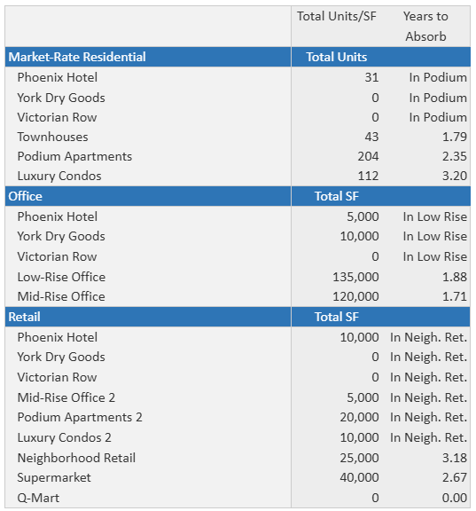
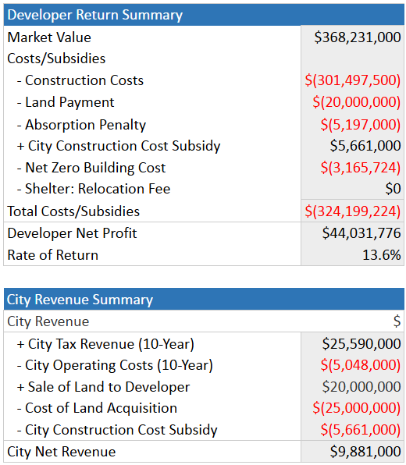
Marketing

