Slide 1
PROGRAM OVERVIEW
The ACE Mentor Program of America, Inc. (ACE) mentors high school students and inspires them to pursue careers in the integrated construction industry – architecture, engineering, construction management, planning and related skilled trades.
Our mission is to engage, excite and enlighten high school students to pursue careers in architecture, engineering, and construction through mentoring and to support their continued advancement in the industry.
More than 10,000 students from almost 1,500 high schools annually participate in ACE. ACE not only engages sponsors and volunteer mentors to expose students to real-world opportunities, it financially supports students’ continued success through scholarships and grants.

Slide 2
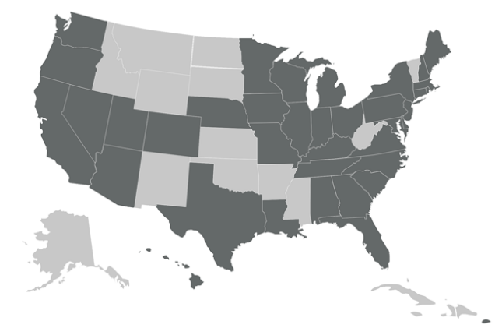
STATISTICAL PROFILE
ACE currently operates in 77 affiliates covering 36 states, the District of Columbia, Puerto Rico and in more than 200 cities.
Over 10,000 students and about 4,100 mentors each year.
ACE has awarded more than $22 million in scholarships to students.
ACE Mentor firms have annually contributed more than $17.5 million worth of pro bono time.
More than 90% of ACE graduates enroll in higher education and two-thirds enter majors linked to the design and construction industry.
Students come from over almost 1,500 high schools, and two-thirds come from underserved or minority communities.
Almost 70% of students are minorities, and one-third are young women.

Slide 3
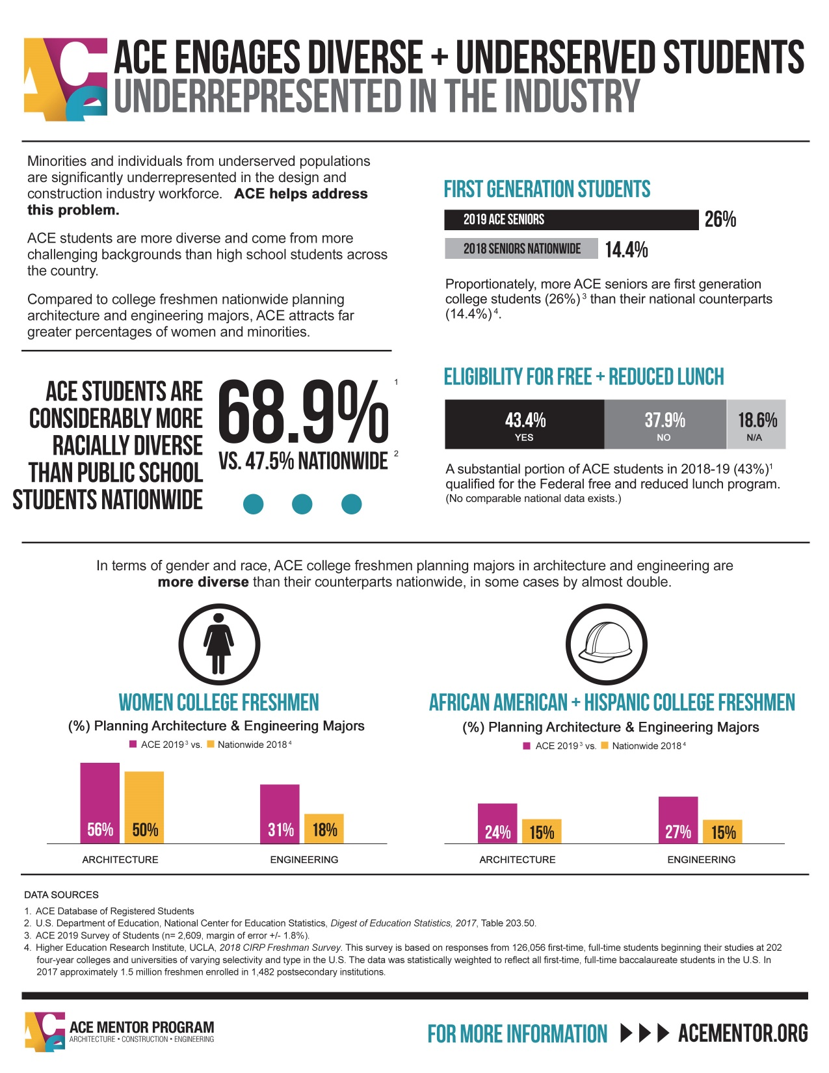

Slide 5
WHO ARE OUR MENTORS?
Architects
Engineers
Landscape Architects
Designers
Urban Designers
Urban and Regional Planners
Construction Management
Project Management
Business and Finance Professionals
Marketing/Graphic Designers
Real-estate Developers
Construction Trades
Teachers/Professors
Environmental Professionals
Social Responsibility Professionals
Transportation Management Professionals

Slide 6
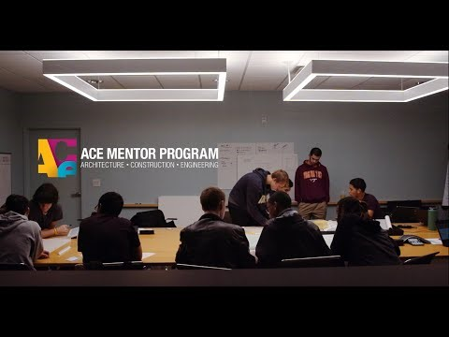

Slide 7
WHY GET INVOLVED WITH ACE MENTOR COLORADO?
Mentors make all the difference.
There is no substitute for experience — the ACE Mentor Program is driven by the committed and enthusiastic participation of volunteer mentors who are practicing professionals in their respective fields. ACE offers high school students the best opportunities because ACE offers the best industry mentors.
Who are ACE mentors?
In our experience, ACE mentors tend to be members of a local community in which an ACE affiliate is located. Clearly passionate about what they do, they often make significant contributions to their communities as role models, trusted friends and career advisors.
What makes a great ACE mentor?
The right mix of knowledge, passion and rapport makes a great ACE mentor. Someone who connects with the students in a way that demonstrates a sincere desire to help, and a commitment to make a difference. ACE mentors are team players willing to dedicate up to 30 hours of their time during the school year.
How ACE mentors gain from the experience.
We hear again and again that ACE mentors experience a profound sense of altruistic "giving back" when involved with ACE and its young participants — the gratification that comes with sharing knowledge and wisdom with eager students. In addition, mentoring presents a variety of networking opportunities, as well as chances to sharpen individual presentation and other professional skills.
Contact us or for more information: acementor.org/colorado

Slide 8
IMPACT
More than 70% of ACE seniors annually enter a skilled trades program or college with an industry-related major.
Large majorities of students report in surveys that as a result of their ACE experience they:
Felt more motivated to attend college
Learned skills and knowledge not taught in their classrooms
Gained useful information about the design and construction industry.
AWARDS
The Presidential Award for Excellence in Science, Mathematics and Engineering Mentoring which was presented at the White House. This is considered the nation’s most distinguished award for mentoring.
Two awards from the American Institute of Architects, one for collaborative achievement and the other for diversity.

