Slide 1
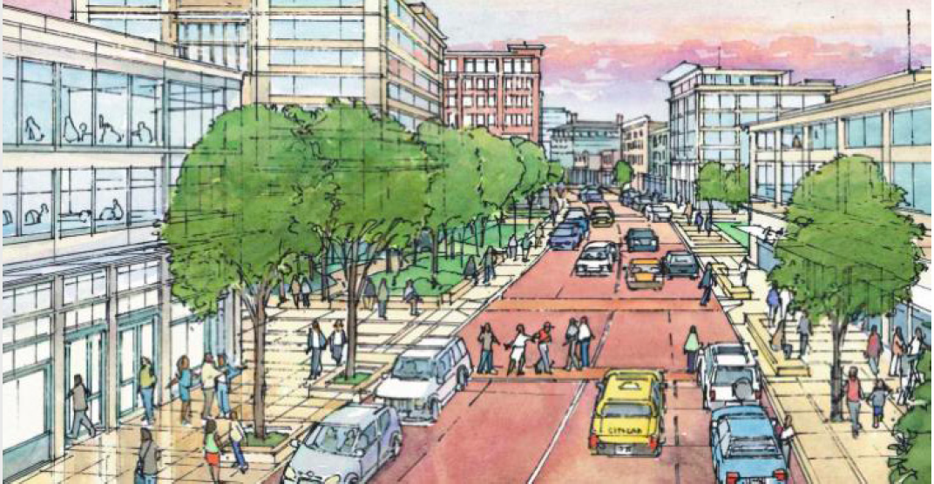
Westphalia TAP
ULI Washington
Friday, November 20th, 2020

Slide 2
ULI is a nonprofit research and education organization supported by its members, representing the entire spectrum of land use and real estate development disciplines working in private enterprise and public service – including leading property owners, investors, advisors, developers, architects, lawyers, lenders, planners, regulators, contractors, engineers, university professors, librarians, students, and interns.

Slide 3
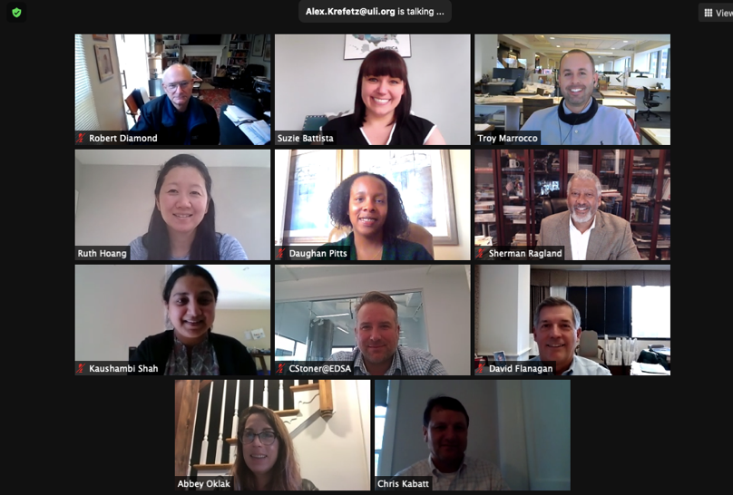
ULI Panelists
Joshua Olsen
Craig Stoner

Slide 4
Agenda
SLIDE TIPS
This agenda is made with SmartArt.
Click into the text boxes or use the SmartArt window to make text changes.
Delete any unnecessary items.
To highlight the current section, change the colour of the chevron behind the item from the standard green to the dark green.
Similarly, to remove the highlight from a section, change the colour of the chevron from dark green to the standard green.
After adding your agenda items, duplicate this slide to create the section index slides.
Existing Conditions +Questions
Land Use
Governance
Funding Mechanisms
Next Steps

Slide 5
Agenda
SLIDE TIPS
This agenda is made with SmartArt.
Click into the text boxes or use the SmartArt window to make text changes.
Delete any unnecessary items.
To highlight the current section, change the colour of the chevron behind the item from the standard green to the dark green.
Similarly, to remove the highlight from a section, change the colour of the chevron from dark green to the standard green.
After adding your agenda items, duplicate this slide to create the section index slides.
Existing Conditions +Questions
Land Use
Governance
Funding Mechanisms
Next Steps

Slide 6
Questions
How can the unique history and features of Westphalia distinguish it from other portions of Prince George’s County? What traits should be prioritized when considering future uses?
What types of uses in the “town center” are best aligned with market trends throughout the Washington region?
What development is feasible in both the short and long term?
How can stakeholders prioritize and finance supportive infrastructure (including planned or potential roads, transit, open space, etc.) for Westphalia?
How can implementation address current transportation needs while accommodating future public transit potential?
Given both present and future conditions related to COVID-19, market trends, and consumer/developer preferences how can placemaking and open space strengthen Westphalia’s identity and foster a sense of community?
What model of governance would be most effective to manage the interests of future residents, property and business owners, and other stakeholders?
Given the existing entitlements and approved land uses, how can the county government and developers achieve the desired uses within Westphalia?
Notes:
What types of uses in the “town center” are best aligned with market trends throughout the Washington region?
• What development is feasible in both the short and long term?
• How can stakeholders prioritize and finance supportive infrastructure (including planned or potential roads, transit, open space, etc.) for Westphalia?
• How can implementation address current transportation needs while accommodating future public transit potential?
• Given both present and future conditions related to COVID-19, market trends, and consumer/developer preferences how can placemaking and open space strengthen Westphalia’s identity and foster a sense of community?
• What model of governance would be most effective to manage the interests of future residents, property and business owners, and other stakeholders?
• Given the existing entitlements and approved land uses, how can the county government and developers achieve the desired uses within Westphalia?

Slide 7
The Westphalia Reality
SLIDE TIPS
These callout elements are made to be copied onto other slides.
Use them to highlight relevant info on photos, diagrams, graphics.
What we really heard from stakeholders, distilled
What Westphalia Could Be
What Westphalia is
Westphalia: Reimagining opportunity. Break the cycle!
What Westphalia isn't
Great location. The land is a huge asset. Proximity and access to DC, major transportation networks. Housing is affordable. County interested in attracting different market sectors. There are features that can create identity. There is untapped potential.
Metrorail is not coming to Westphalia. Office and regional retail are not coming to Westphalia. It has been hard to attract a grocery store. County is not focused on Westphalia. Vision as planned and sold has not been fulfilled. Communication isn't working. Current plan implementation isn't working.

Slide 8
Agenda
SLIDE TIPS
This agenda is made with SmartArt.
Click into the text boxes or use the SmartArt window to make text changes.
Delete any unnecessary items.
To highlight the current section, change the colour of the chevron behind the item from the standard green to the dark green.
Similarly, to remove the highlight from a section, change the colour of the chevron from dark green to the standard green.
After adding your agenda items, duplicate this slide to create the section index slides.
Land Use
Existing Conditions + Questions
Governance
Funding Mechanisms
Next Steps

Slide 9
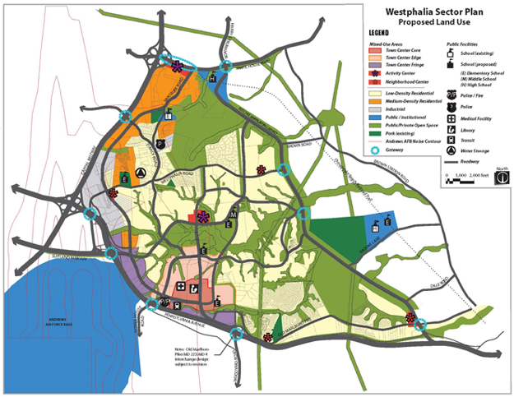
Existing Conditions
Existing 2007 Sector Plan is good and valid, but becoming outdated:
Metro not expanding to site
Strong demand from housing crisis
Excess retail space in the County
Future office space now directed to Metro sites
Cooperation between Developers & PG County needs to continue
Plan implementation is off to a solid start – though certain elements can be enhanced
Lack of community elements delivered from original Vision causing Resident frustration. Normal issue, but requires improved communication and patience
Recent Private Investment in the Community
Opportunities for connections to Open Space
Deep roots in agricultural history

Slide 10
Key Discussion Points
Land Use
Tweak the Sector Plan
Understand what has been done right
Identify new market opportunities
Right-size the Density & associated Transportation Network
No longer "Reston", but still can have community feel and be unique
Adapt to Trends & Current Market Conditions
"Experiential", neighborhood-focused retail, restaurants & offerings
Create community / civic draw
Additional housing products / typologies
Explore alternate land uses
Alternative Transit & Streetscape
Create Regional Trail Network
Right-size Street Sections
Study BRT & other methods
Pedestrian-focused amenities
Create Short-Term Activation
"Tactical Urbanism"
Pop-Up Opportunities / Events
Impactful Upcoming Development to engage the Community

Slide 11
Trends
Take advantage of Current Market Trends and Wait for Others to Return
Increasing outdoor amenities for people
Demand of "For sale" and Rental residential housing increasing
Focus on local serving retail
Outdoor dining and entertainment uses evolving with the current situation
Warehousing and data centers to accommodate increased demand for e-commerce and remote working
Less large format / big box retail
Less large, commercial office complexes
Less high density far from Metro stations

Slide 12
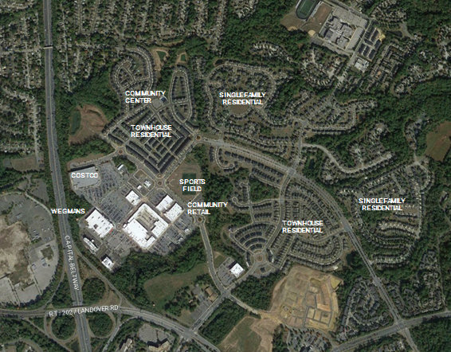
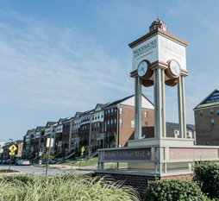
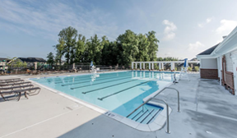
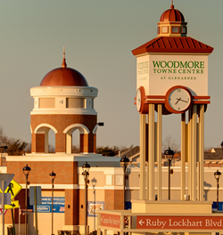
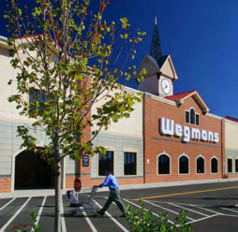
Product Example
Woodmore Town Centre – Glenarden, Maryland
Notes:
Photo sources?

Slide 13
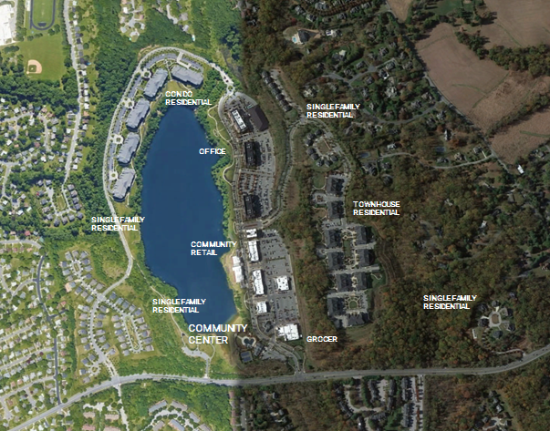
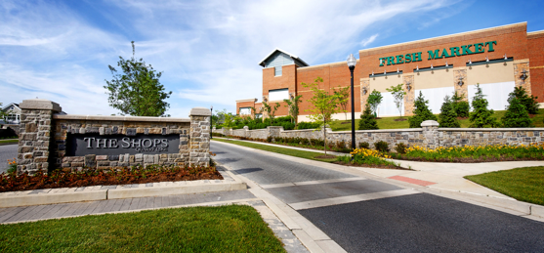
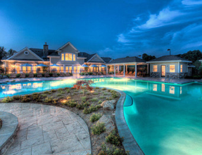
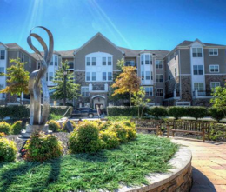
Product Example
Quarry Lake at Greenspring – Baltimore, Maryland

Slide 14
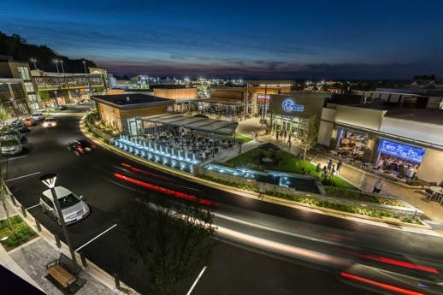
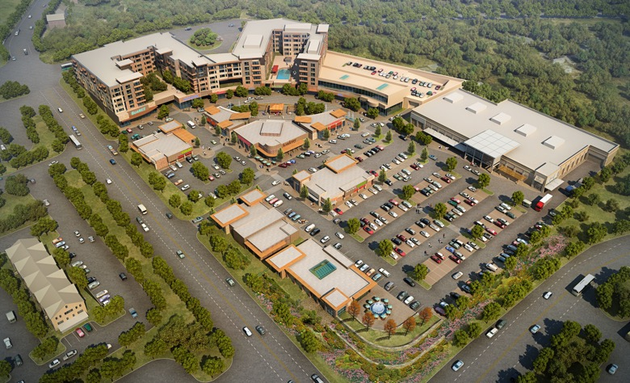
Product Example
Community Retail Mixed-Use Centers
Wegmans Development, etc
Grocery Lead Mixed-Use Example 1
Cascades Overlook
Sterling, Virginia
Notes:
Images from Troy

Slide 15
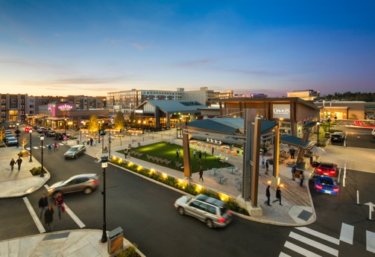
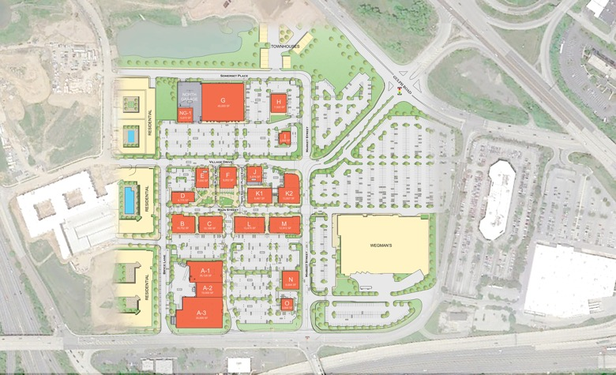
Product Example
Community Retail Mixed-Use Centers
Wegmans Development, etc
Grocery Adjacent,
Horizontal Mixed-Use Example 2
King of Prussia Town Center
King of Prussia, PA
Notes:
Images from Troy

Slide 16
Tweaks to the Sector Plan
Slight changes can update the plan for today’s market conditions
Right-size the land uses to what is possible today and in the near future
Less office and more housing choices
Appropriate retail
Revisions now will help:
Strengthen the Community through build-out
Increase absorption
Accelerate amenity construction
Reduce resident frustrations
Match traffic network to these right-sized densities
Implement Multi—Modal options and Complete Streets infrastructure

Slide 17
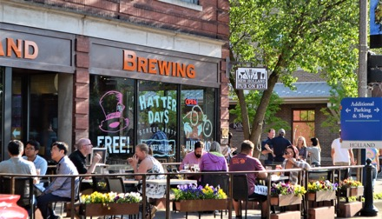
Tweaks to the Sector Plan
Slight changes can update the plan to today’s market conditions
Create Civic / Public Draw
Heartbeat of a Community
Regional Community / Recreation Center
Potential for users from JBA
Complete large parks and trail system. Hold events in the new parks.
Library
Add a wide variety of housing types and price points
Multi-Generational Housing
Neo-Traditional Single Family
Condominium Stacked Flats
Rental Apartments
Explore Warehousing / Data Center Opportunities
Flexibility in Development to adjust to market
Considerations for Medical Office, 2-3 story Office with surface parking, with ground-level Retail and Multi-family housing above
Future development of surface lots
Accelerate School Construction Planning
Demand will rapidly rise due to accelerated home construction
Charter School Exploration
Notes:
Images: BCT Image Archive – Usage Rights via Twenty20

Slide 18
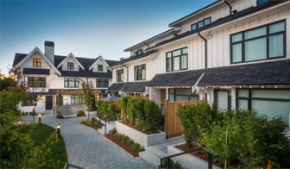
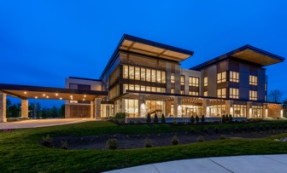
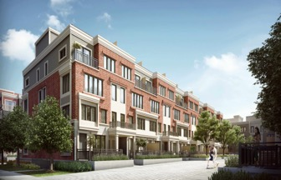
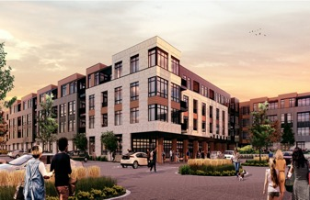
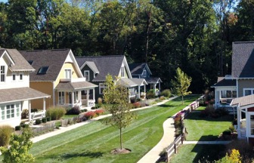
Different Use Types: Residential
Expand offerings in the Sector Plan
Single-Family
Townhouses
Senior Housing
2 over 2 / Stacked Flats
Multi-Family
Single Family Rental / Cottage Court
Source: xxx
Notes:
Images:
Top: (1) https://www.google.com/url?sa=i&url=https%3A%2F%2Fwww.devonleighhomes.com%2Fabout%2Fblog%2F&psig=AOvVaw1smUrqov8ABgOHjvxXlJFv&ust=1605906983134000&source=images&cd=vfe&ved=2ahUKEwj8jbnrw4_tAhUBWt8KHa4VAOsQr4kDegUIARCfAQ
(2) https://www.google.com/url?sa=i&url=http%3A%2F%2Fstuarthoward.com%2F%3Fportfolio%3Dst-george-apartment&psig=AOvVaw23CenSzcpLfyGW8Ll0mOgx&ust=1605907046947000&source=images&cd=vfe&ved=2ahUKEwjO9--JxI_tAhVVJVkFHf8iBnsQr4kDegQIARA2
(3) BCT Design Group
Bottom:
(1) https://www.google.com/url?sa=i&url=https%3A%2F%2Fwww.livabl.com%2F2016%2F09%2Fregister-vip-preview-minto-longbranch-2.html&psig=AOvVaw2b6Hj78QFty_RzboFnEw8M&ust=1605907097290000&source=images&cd=vfe&ved=0CAMQjB1qFwoTCMCHgaLEj-0CFQAAAAAdAAAAABAD
(2) BCT Design Group
(3) https://www.google.com/url?sa=i&url=https%3A%2F%2Fwww.pinterest.de%2Fpin%2F167548048621866786%2F&psig=AOvVaw1a_rBAOlOE2Y7WFNoCB_Rb&ust=1605907152889000&source=images&cd=vfe&ved=0CAMQjB1qFwoTCODNo7zEj-0CFQAAAAAdAAAAABAD

Slide 19
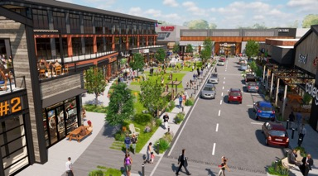
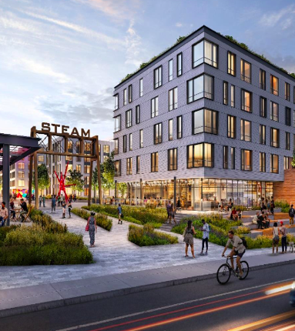
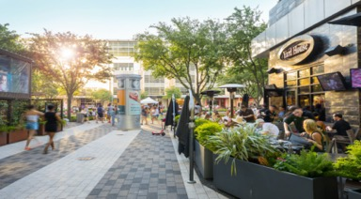
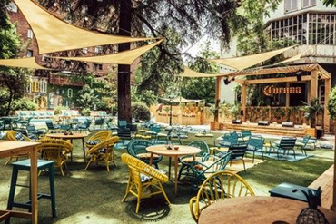
Different Use Types: Mixed-Use
Expand offerings in the Sector Plan
Low-scale Office over Retail
Local Restaurants & Outdoor Dining
Outdoor Plazas & Amenities
Notes:
Images
Top : (1) BCT Design Group;
(2) https://www.google.com/url?sa=i&url=https%3A%2F%2Fwww.thesanjoseblog.com%2F2014%2F01%2Fsantana-row-in-january-february-and.html&psig=AOvVaw3wUVaXde_HHFIWlH4JtD_5&ust=1605906633134000&source=images&cd=vfe&ved=0CAkQjhxqFwoTCIiInMbCj-0CFQAAAAAdAAAAABAD
Bottom: (1) https://www.google.com/url?sa=i&url=https%3A%2F%2Fcitycentrehouston.com%2Fuploads%2Fimg%2Fcontent%2F200323_CITYCENTRE_-_Retail_Leasing_Brochure_WEB.pdf&psig=AOvVaw31OWXa_XJe1XiVER7ElN39&ust=1605906699602000&source=images&cd=vfe&ved=0CAMQjB1qFwoTCOis0uTCj-0CFQAAAAAdAAAAABAD
(2)

Slide 20
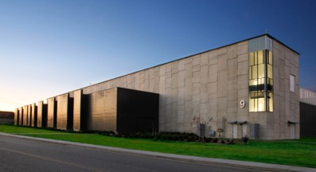
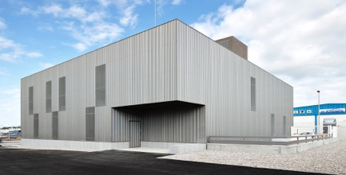
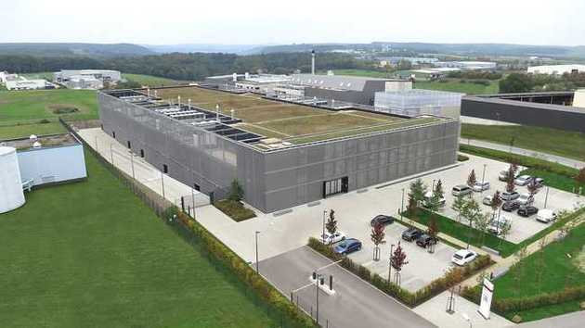
Different Use Types: Warehousing / Light Industrial / Data Centers
Expand offerings in the Sector Plan
e-Commerce
Light Industrial
Warehouse
Data Centers
Notes:
Images
Top: (1) https://www.google.com/url?sa=i&url=https%3A%2F%2Fcreelighting-canada.com%2Fapplications%2Findustrial-warehouse%2F&psig=AOvVaw2CJm9yeGjke6jkffXe8PVj&ust=1605964335841000&source=images&cd=vfe&ved=0CAMQjB1qFwoTCLD45L-Zke0CFQAAAAAdAAAAABAD
(2) https://www.google.com/url?sa=i&url=https%3A%2F%2Fwww.datacenterdynamics.com%2Fen%2Fnews%2Fequinix-plans-san-jose-expansion-report%2F&psig=AOvVaw3ppErIc3QGe-2kPEYzZQM5&ust=1605907228004000&source=images&cd=vfe&ved=0CAMQjB1qFwoTCKDiwuDEj-0CFQAAAAAdAAAAABAD
Bottom: (1) https://www.archdaily.com/926816/cl-warehouses-vaga?ad_source=search&ad_medium=search_result_projects

Slide 21
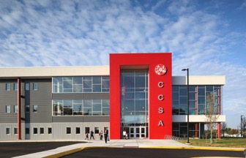
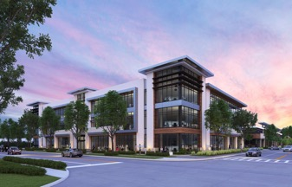
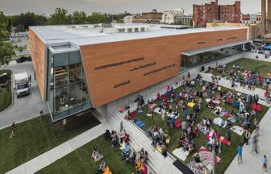
Different Use Types: Medical & Civic Facilities
Expand offerings in the Sector Plan
Medical Office
Charter School
Health Clinic
Library
Source: xxx
Notes:
Images:
L: https://www.google.com/url?sa=i&url=https%3A%2F%2Fhmcarchitects.com%2Fnews%2Ftake-5-chris-naughton%2F&psig=AOvVaw2L9gUYIHB2dr3VdjRefoSO&ust=1605907276612000&source=images&cd=vfe&ved=2ahUKEwjzyLH3xI_tAhVBBFkFHbEhDScQr4kDegQIARAY
R: https://www.bizjournals.com/southflorida/news/2019/03/05/mas-group-to-break-ground-on-medical-office.html

Slide 22
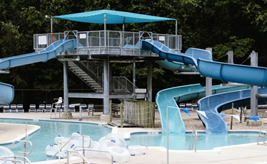
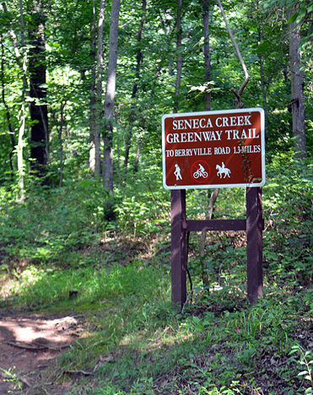
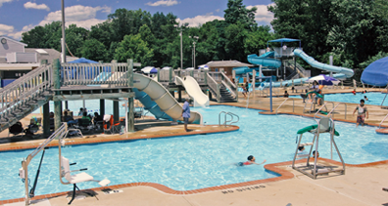
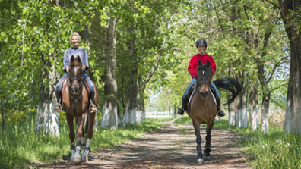
Different Use Types: Community Facilities
Expand offerings in the Sector Plan
Community Centers
Trails
Regional Amenities
Notes:
Images:
L: https://www.google.com/url?sa=i&url=https%3A%2F%2Fgreenvillerec.com%2Fparks%2Fpavilion-recreation-complex%2F&psig=AOvVaw14xPlWGUSaQqWC2d5VK_ks&ust=1605907360501000&source=images&cd=vfe&ved=2ahUKEwim27GfxY_tAhXQBVkFHepBA_AQr4kDegQIARAW
R: Trail: Cooper Carry Image archive (no source available)

Slide 23
Approved Sector Plan
A Connected Transportation Network with Alternative Street and Transit Options
Trails and bike facilities
Right-size street sections
Study BRT and Bus Routing Options

Slide 24
Urban Boulevard
Presidential Parkway
Existing – Auto Focused
Multi-modal, complete street
Nacto.org

Slide 25
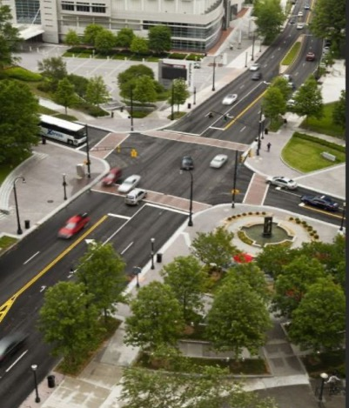
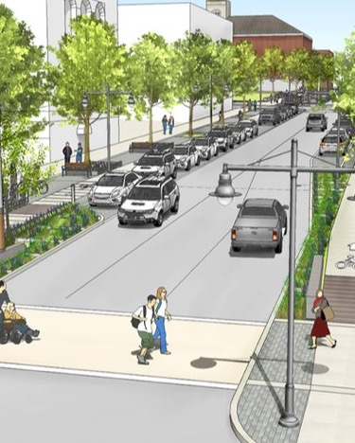
Urban Street Design
Walkable Streets

Slide 26
Collector Street
Westphalia Road – Rural Character
Existing
Multi-modal

Slide 27
Transit Options
Connections to job centers, commercial centers and adjacent communities
Autonomous shuttles
Multiple bus lines and Bus Rapid Transit

Slide 28
Create Short-Term Activation
Increase awareness and begin bringing people to the site
"Tactical Urbanism"
Energize
Socialize
Entertain
Engage
Short-term, low-cost & scalable interventions to catalyze long term change
Offerings that are "Community-Focused" & Convenient
Small Grocery / Market
Drug Store
Coffee Shop
Local Chef Concept
Fitness / Entertainment
Notes:
Images:
R: TU diagram from Troy
Vision
Highlighting signature qualities of the sector/neighborhoods
Difficult to come up with one vision statement for all the discrete neighborhoods
Neighborhood-serving retail – “one-stop shopping”
Grocery store
Coffee shop
Drug store
Dining
Entertainment
Fitness
An umbrella organization for residents, developers, and government

Slide 29
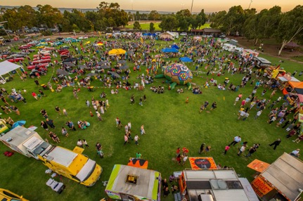
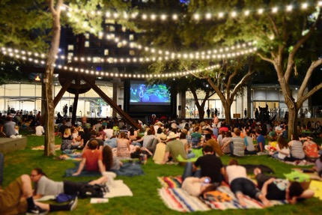
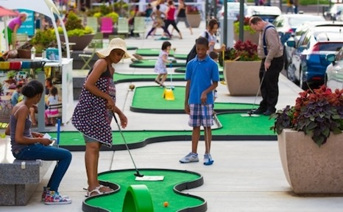
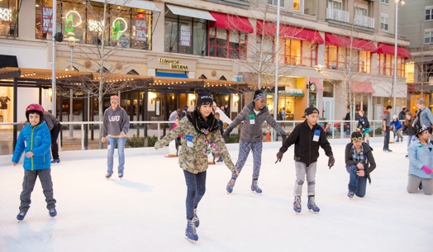
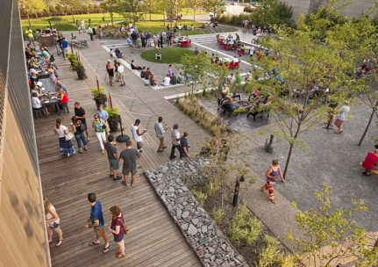
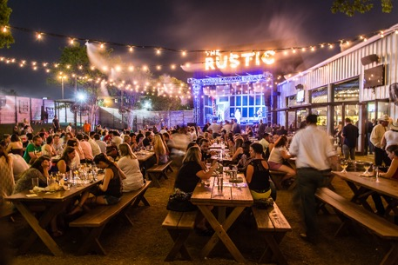
Food Truck Rally
Community Movie Night
Pop-Up Activities
Seasonal Ice Rink
Social Beer Garden
Temporary Concert Venue
Notes:
Images:
LT: Food truck event from Troy
LB: https://www.highlandschamber.org/articles/post/highlands-ice-skating-rink/
MT: Movie in the park from Troy
MB: Brewery Image from Troy
RT: Putt Putt Image from Troy
RB: Outdoor Concert Image from Troy

Slide 30
Recommendations
Update the 2007 Westphalia Sector Plan
Goals
Identify land uses that are more compatible with today's market
Right-size the density and associated transportation network to be more aligned the notion that this region will not be a Metro Center
Work with Westphalia Town Center to create community-focused future development
Goals
Right-size the density and associated transportation network to be more aligned the notion that this region will not be a Metro Center
Focus on community-centric, experiential, retail, restaurants & open spaces
Evaluate housing products / typologies against current market.
Explore alternate compatible land uses
Work within the current plan framework to enable short term buildout
Alternative Transit & Streetscape
Goals
Develop regional open space study with focus on community focused amenities with County and Developers
Right-size Street Sections in all regions of Westphalia
Study Bus Rapid Transit (BRT) & Alternative Methods
Identify multi-modal and Complete Street opportunities
Short Team Initiatives
Goals
Complete transportation improvements.
Identify location of for "Tactical Urbanism" & Pop-Up Events
Engagement of Community to better understand needs from land use standpoint
Types of Retail
Type of Housing
Community Amenities

Slide 31
Agenda
SLIDE TIPS
This agenda is made with SmartArt.
Click into the text boxes or use the SmartArt window to make text changes.
Delete any unnecessary items.
To highlight the current section, change the colour of the chevron behind the item from the standard green to the dark green.
Similarly, to remove the highlight from a section, change the colour of the chevron from dark green to the standard green.
After adding your agenda items, duplicate this slide to create the section index slides.
Governance
Existing Conditions + Questions
Land Use
Funding Mechanisms
Next Steps

Slide 32
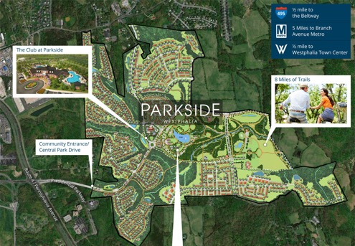
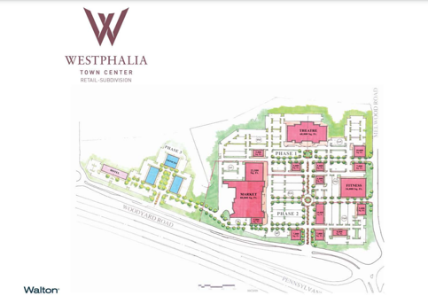
Challenges
Place, Identity and Vision
Sector-wide and within existing communities
“City in the country”
Competition within the county
Signage and Wayfinding
Designing materials
Ensuring use throughout Westphalia
Attracting the right fit of retail
Existing Organization/Community Groups
Coordinating across multiple developers
Creating a trail network
Development maps of Parkside and Westphalia Town Center
Notes:
Maps: https://www.parksidemaryland.com/community/
Town Center Image – cut Central Park portion
Town Center Map - http://westphalia.com/wp-content/uploads/2020/06/Westphalia-Retail-SiteMap-web.pdf

Slide 33
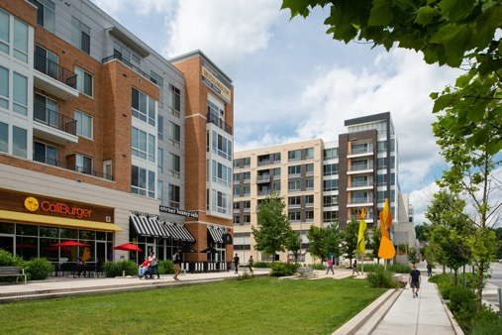
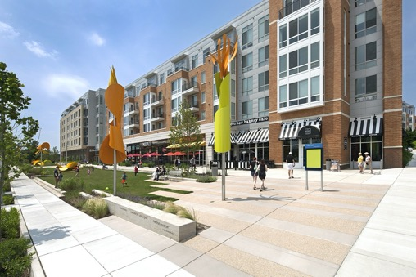
Aspirations
Columbia, Maryland
10 villages with an urban downtown with mixed-use
Columbia Association as an organizing model
Maintains common areas
Shared space/amenities – parks, trails, pools, tot lots, playing fields
Empowering residents to operate their community once building phase is complete
Vision
Highlighting signature qualities of the sector/neighborhoods
Difficult to come up with one vision statement for all the discrete neighborhoods
Columbia, MD
Notes:
https://www.google.com/url?sa=i&url=https%3A%2F%2Fwww.designcollective.com%2Fportfolio%2Fproject%2Fkettler--howard-hughes--the-metropolitan%2F&psig=AOvVaw2AdSkCY0GD43mj6OhsWU03&ust=1605822429994000&source=images&cd=vfe&ved=0CAIQjRxqFwoTCJjn4f6Ije0CFQAAAAAdAAAAABA_
https://www.designcollective.com/files/projects/gallery/783_12_n40_adobe.jpg
What you know
-Columbia MD
What you think you know
-Lessons that could apply to Westphalia
-Columbia MD
What you should know
-Mclean
HOA – empowering residents to make change in their community once the developer steps out May work in individual neighborhoods, but hasn’t and won’t work sector wide
Not just that, the existing HOA/Town Center developer aren’t doing all the things a Master developer normally would. Lack neighborhood/community building.
-Recreation tax/facility? MNCPPC would build facilities instead of developers on their sites, fund like a TIF, bring community together (they would have to pay).
-Don’t typically see developers giving $ and acerage in PG
-Westphalia club house built by developer, supported by HOA. Next Developer would instead put the money into a fund and M-NCPPC builds

Slide 34
Westphalia Civic Association
An umbrella organization for HOS, major landholders, and Westphalia Stakeholders
Empower residents, create seat at the table, transition from building phase to management phase
Members:
Existing HOAs
Large landholders
Park and planning (advisory role)
Examples of civic associations
McLean Citizens Association
Community Association of South Bowie
Goals/Objectives –
Short (1-2 years) – Westphalia identity + branding, signage and wayfinding
Mid (3 – 5 years) –advocating for Improvements (Public Private Partnerships (PPP), outreach to Andrews, working with Council on supportive legislation, schools)
Long (5+ years) – BID, financing function, Participate in revision of Sector Plan
Westphalia Civic Assoc.
Existing HOA’s
Future HOA's
Key Stakeholders
Landholders
Elected Officials
Advisory role
Elected Officials
County Staff
Notes:
Existing Long term neighborhood names (not just existing HOA’s)
“Existing HOA’s” – get away from short
“Future HOA’s”
“Key Stakeholders”
Landholders
Elected/County Staff as Advisory
What you know
-Columbia MD
What you think you know
-Lessons that could apply to Westphalia
-Columbia MD
What you should know
-Mclean
HOA – empowering residents to make change in their community once the developer steps out May work in individual neighborhoods, but hasn’t and won’t work sector wide
Not just that, the existing HOA/Town Center developer aren’t doing all the things a Master developer normally would. Lack neighborhood/community building.
-Recreation tax/facility? MNCPPC would build facilities instead of developers on their sites, fund like a TIF, bring community together (they would have to pay).
-Don’t typically see developers giving $ and acerage in PG
-Westphalia club house built by developer, supported by HOA. Next Developer would instead put the money into a fund and M-NCPPC builds

Slide 35
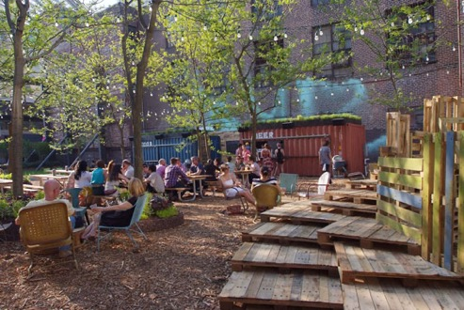
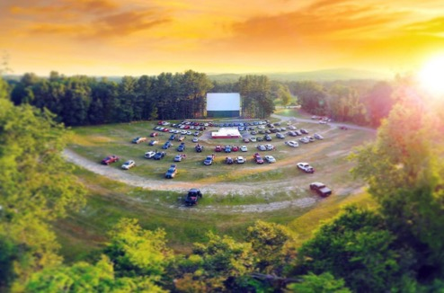
Placemaking Concepts
Pop Ups at Westphalia
Farmers market
Seasonal activities - ice skating, beer garden, drive in movie theater
Art installations
Proof of concept for the retail; can demonstrate use and draw makes it easier to sell retail
Attracting visitors from Joint Base Andrews
Seasonal amenities can serve residents while building interest for additional development
Notes:
https://1tr3cf2wfvdq38ywv9115vd6-wpengine.netdna-ssl.com/wp-content/uploads/2018/04/parks-on-tap.jpg
https://www.wideopencountry.com/30-best-drive-in-movie-theaters-in-the-country/
https://www.ediblecommunities.com/wp-content/uploads/2019/06/farmers-market-stall-600x617.jpg
https://worldlandscapearchitect.com/2013/groundswell/beer/PopUp_2.jpg

Slide 36
Agenda
SLIDE TIPS
This agenda is made with SmartArt.
Click into the text boxes or use the SmartArt window to make text changes.
Delete any unnecessary items.
To highlight the current section, change the colour of the chevron behind the item from the standard green to the dark green.
Similarly, to remove the highlight from a section, change the colour of the chevron from dark green to the standard green.
After adding your agenda items, duplicate this slide to create the section index slides.
Funding Mechanisms
Existing Conditions + Questions
Land Use
Governance
Next Steps

Slide 37
Westphalia: The Chicken and Egg Problem
Existing residents want amenities that they were promised.
But the money to pay for these amenities has to come from development.
So more development has to happen, exacerbating the lack of amenities, before there’s enough money to pay for the amenities.
$$$
Community Amenities
Residents
(“Rooftops”)

Slide 38
Need a Catalyst
We need to get the cycle going again
The obvious options have already been tried. Need to be creative
Create a virtuous cycle!
Notes:
What do we mean by catalyst? Civic Use, Retail Use, etc? Toolbox of options for the sponsor to consider.

Slide 39
Creative Ideas to Incentivize and Fund Catalytic Development
Incentivizing development will require a sponsor or lead entity
Developer Led
Subsidizing desired retail development
Leverage high demand uses to fund desired uses
Attract retail using structures that lower upfront costs to retailers
Shipping Container / Modular Development
Food hall concept
Community Led
Seek out funding sources for specific community-oriented / cultural / civic development projects
Grants
Municipal Led
Redirecting PFFIP funds to other uses
Monetizing excess land
Watershed Cleanup
Food Hall
Shipping Container Retail
Notes:
Capitalize on increase in land value. If additional development increase land value, use that cash flow stream to pay off debt/create additional amenities (baby TIF)
Focus on HOA – master homeowners association funding
Can required transportation projects be redirected to another public infrastructure/benefit
Graphic

Slide 40
Excess “Central Park” Land
M-NCCPC sells excess land (112 acres) associated with the Central Park.
Resulting funds can be partially used for construction of the planned park.
Remaining funds directed toward other needed amenities, perhaps with matching funds from developers: trail network, retail center, etc.
Or monetize the land some other way
Ground lease the land for the development of rental product – multifamily, or more likely, single-family rental.
Contribute the land for development in a PPP or joint venture
Participate in the development profit
Some of the additional revenue could go to other M-NCCPC needs
Keep it simple!
Planned Central Park

Slide 41
Grocer Subsidy
To get a grocer before more households are in place, a subsidy is needed.
But that subsidy does not need to last forever, and the subsidy can be scaled to the need.
This graph shows the subsidy in terms of rent, but it could take (partially or wholly, depending on the need) the form of a tax abatement or a contribution to upfront costs like parking or tenant improvements.
Households and Grocer Rent
Regular Rent
Free Rent
Percentage Rent
Rent
3,000 3,500 4,000 4,500 5,000 5,500 6,000 6,500 7,000 7,500 8,000 8,500
Households
Notes:
Tipping point for a grocer

Slide 42
Toolbox for Incentivizing Development
Lower Upfront Costs
Developer subsidy, free land
Lower Ongoing Costs
Tax abatement
Lower financing costs
Seek out low/no-interest loans/bonds
Pay for public items with public funds at lower rates
Invest future impacts into the project
TIF (exists)
Synthetic TIF
Special taxing district
Community Development Authority
Notes:
Mosaic District
The Line hotel DC

Slide 43
Data Centers and Electrical Infrastructure
The County is interested in attracting data centers
They do not generate much traffic and therefore can be close to residential.
They are very valuable and would help diversify the County’s tax base.
The jobs they attract are generally high-paying.
Data centers need electrical power.
Lots of it.
Redundant power.

Slide 44
How to Get the Electrical Infrastructure?
Team up with a partner
Joint Base Andrews (JBA) is already interested in getting an additional substation to provide redundant power to the base. They have already approached Pepco about this.
The County and JBA, combined, might have enough leverage to get a new substation from Pepco.
Have an area where the zoning allows for data center development.
Have a data center developer (or better yet, user) that is interested in developing once the infrastructure is in place.
First phase may need inexpensive land, but later phases could pay more for land as a hub develops.
Consider other electric companies.

Slide 45
Agenda
SLIDE TIPS
This agenda is made with SmartArt.
Click into the text boxes or use the SmartArt window to make text changes.
Delete any unnecessary items.
To highlight the current section, change the colour of the chevron behind the item from the standard green to the dark green.
Similarly, to remove the highlight from a section, change the colour of the chevron from dark green to the standard green.
After adding your agenda items, duplicate this slide to create the section index slides.
Next Steps
Existing Conditions + Questions
Land Use
Governance
Funding Mechanisms

Slide 46
Short Term Actions with Long Term Benefit
Land Use
Governance
Funding
Engage community to better understand the needs from a land use standpoint:
Types of retail
Types of housing
Community amenities
Complete transportation improvements
Identify locations to provide "Tactical Urbanism" & impactful Pop-Up opportunities
Create an identity and an umbrella organization
Coordination and communication among stakeholders
Empower residents and influence government
Help developers achieve a realistic vision for the community
Identify a source of funds that can pay for amenities, which in turn will be a catalyst for the development of the area
Pick a strategy for incentivizing retail development
Identify partner(s) that will lobby Pepco for a new substation, which is needed for data center development

