Slide 1
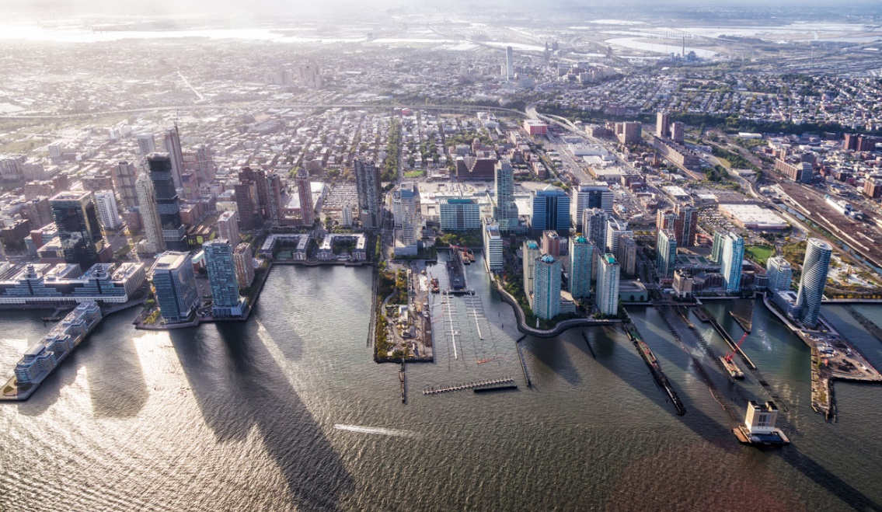
Asheville, NC
George Ashton Strategic Investments, Managing Director

Slide 2
Table
of Contents
2019 Photo – Charlotte, NC
01
LISC OVERVIEW
02
GROUP DICIPLINES
03
SERVICES
WHO WE ARE
WHAT WE DO
HOW WE DO IT
LISC
Strategic Investments Group
Opportunity Zones
Innovative Impact Investments
Capital-raising
Impact Investing
Impact Real Estate Development
Specialized Fund Management
04
PROJECT PIPELINE
05
COMPETITIVE ADVANTAGES
06
CONTACT INFORMATION
WHERE WE’RE WORKING
WHY WORK WITH US
NEXT STEPS
Our Footprint – Current Projects
For Investors
For Developers
For Local Stakeholders
Tools & Resources
Setting up a meeting
Contact Investor Relations

Slide 4
“Our work is always informed by what we learn from the people who are going to be impacted by the investments we make in their community. So, we make sure they are at the table when programs or initiatives are being designed.”
- Maurice Jones, LISC CEO

Slide 5
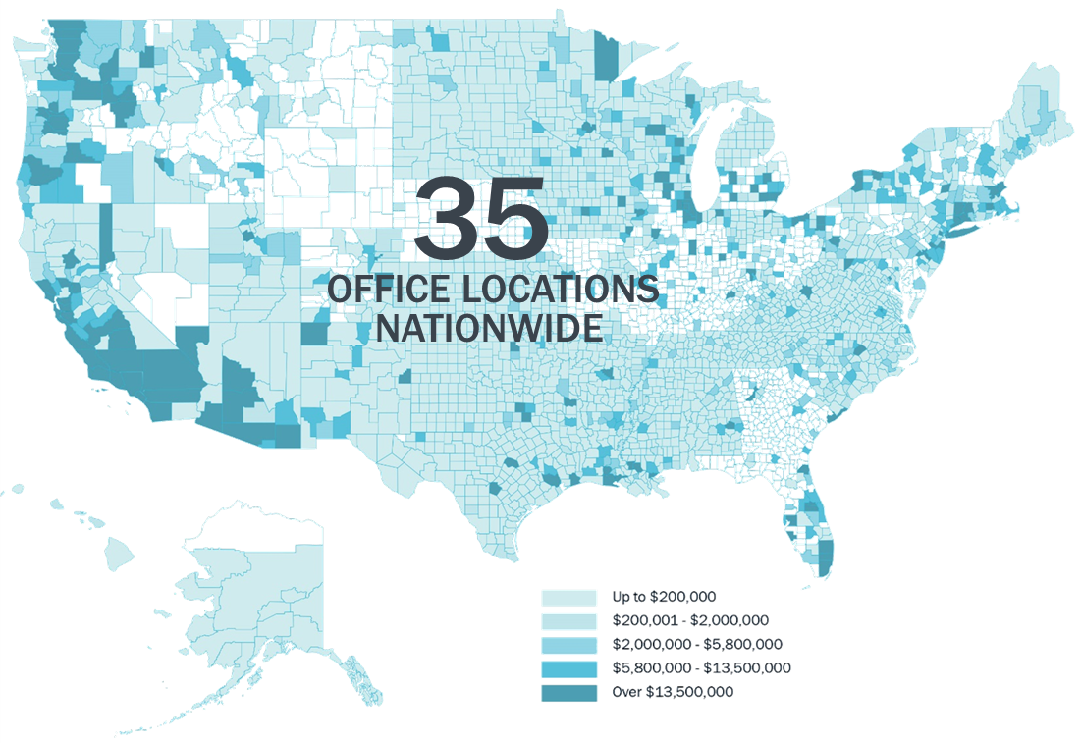
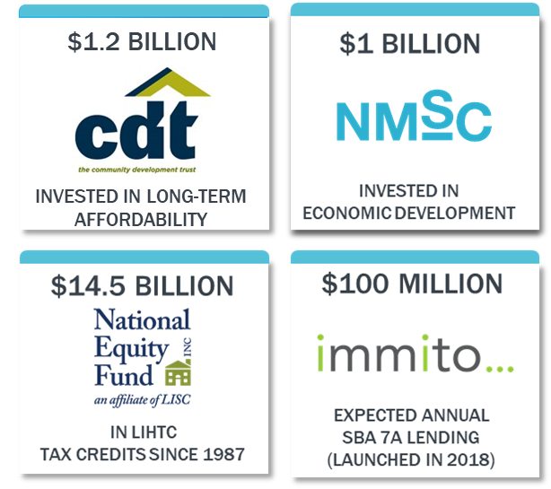
One of the nation’s largest community development financial institutions
We create opportunities for people to thrive.
Our Investment Companies.
5
5

Slide 6
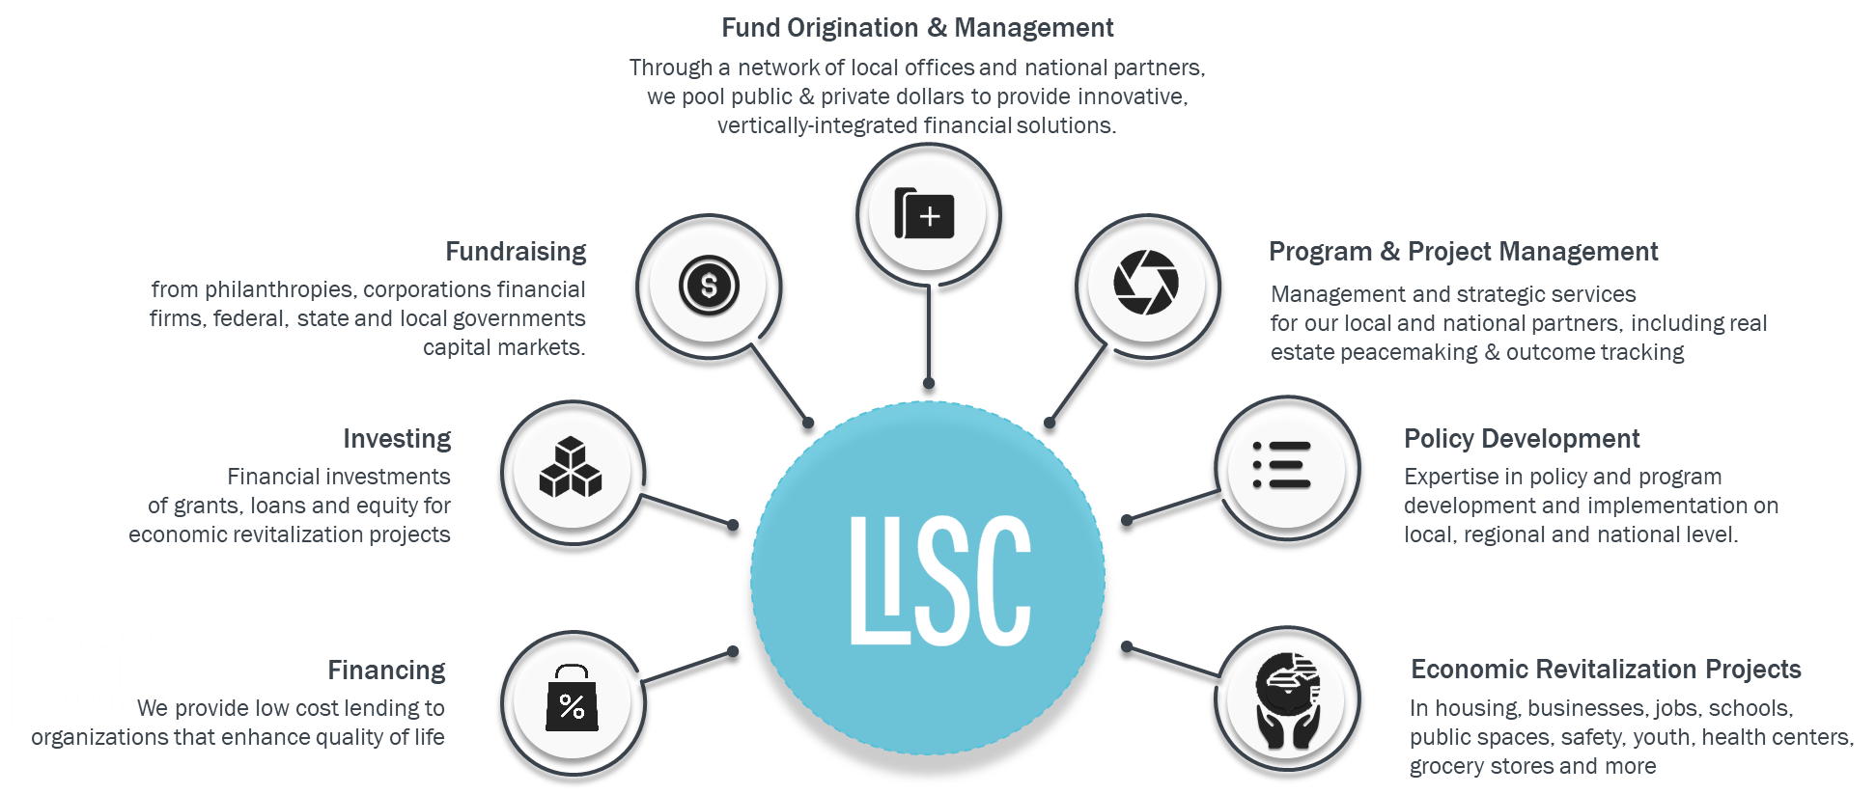
Our work impacts the lives of millions of Americans.
6
6

Slide 7
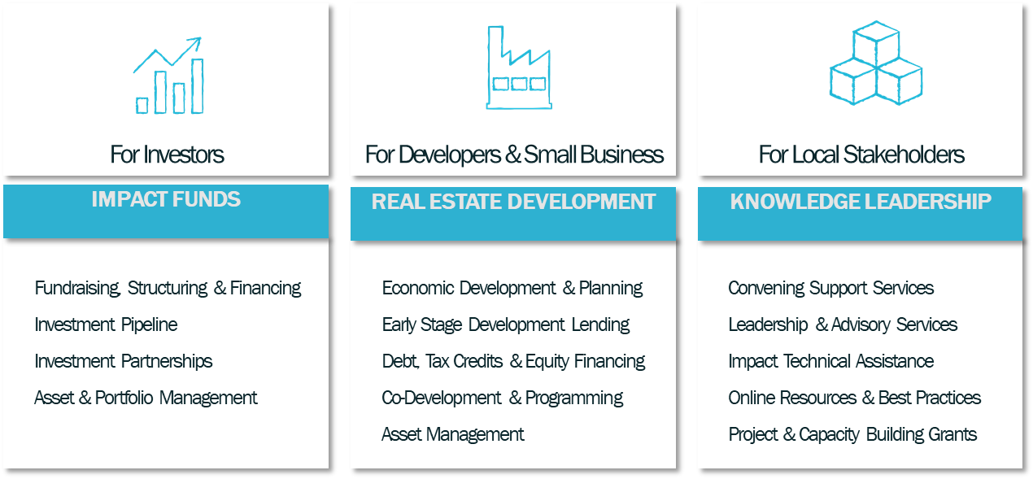
Strategic Investments Group Services
Attractive Returns
Responsive Development
Economic Advancement

Slide 8
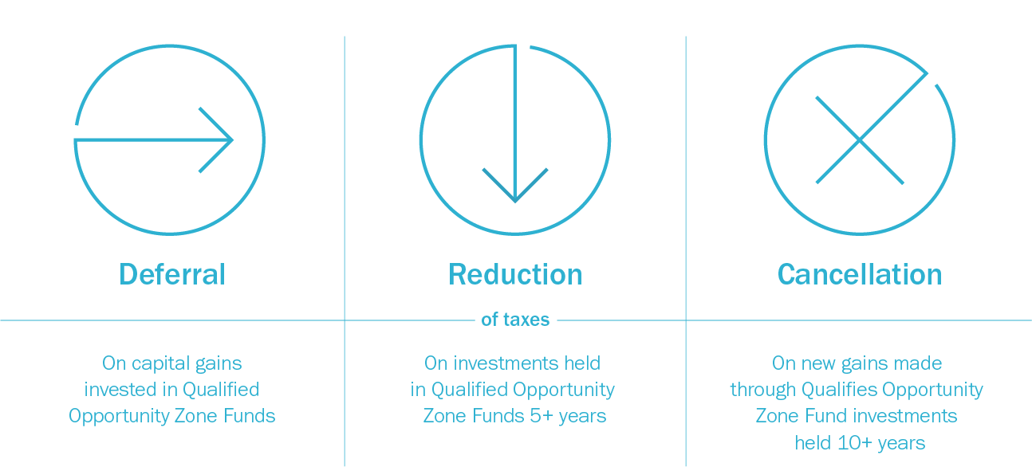
Opportunity Zones Investor Tax Incentive
OZ Investment Premise
Lower the cost of equity investment
Open investors up to new under-invested geographies
Incentive for local and federal government to organize their resources around this cause
With enough interest in these areas – the development risks begin to diminish

Slide 9
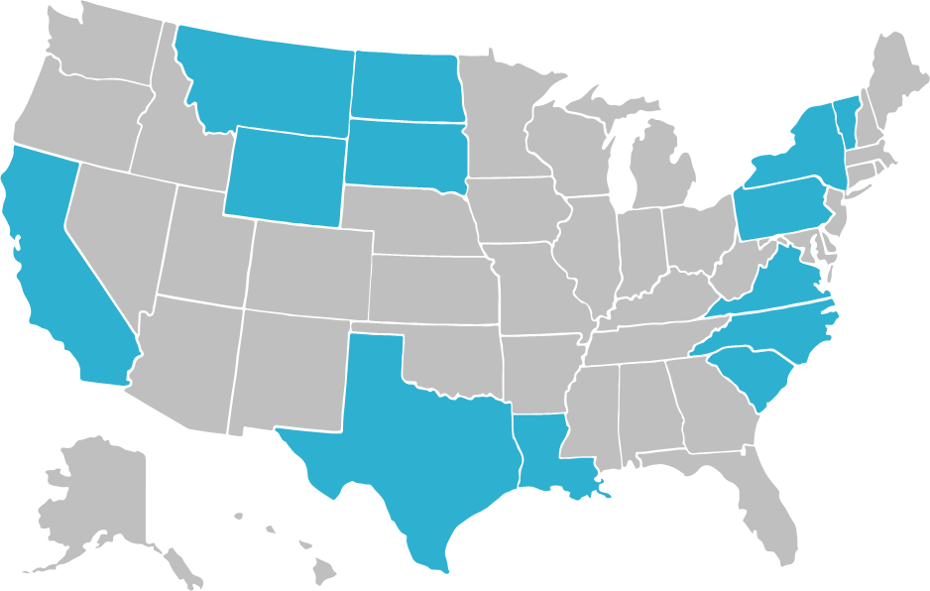
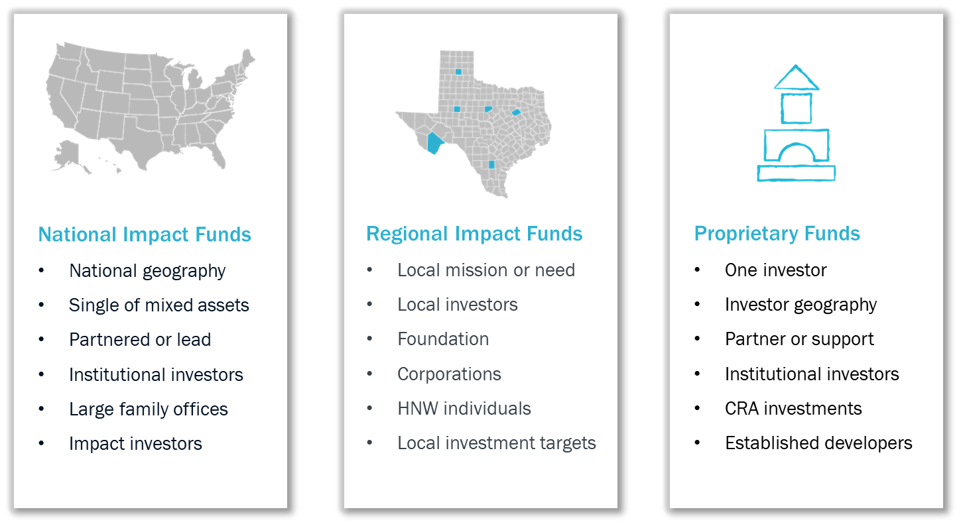
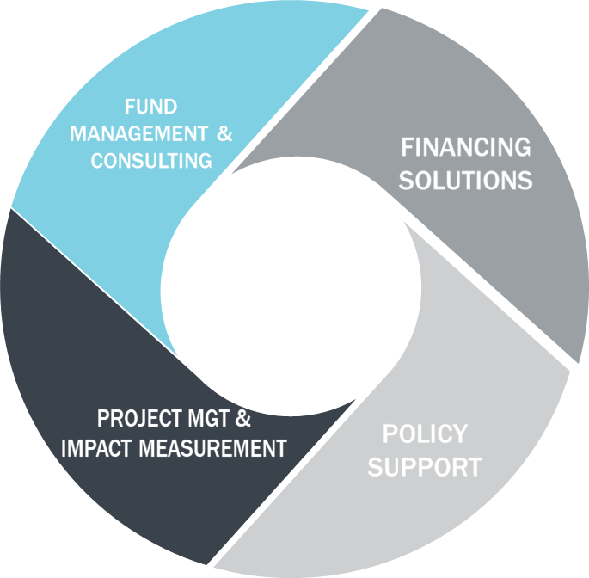
LISC Fund Types
Other Ways to Partner
Debt Partner
Tax Credits
Structuring & Fund Management
Program & Grant Support
Policy Support

Slide 10
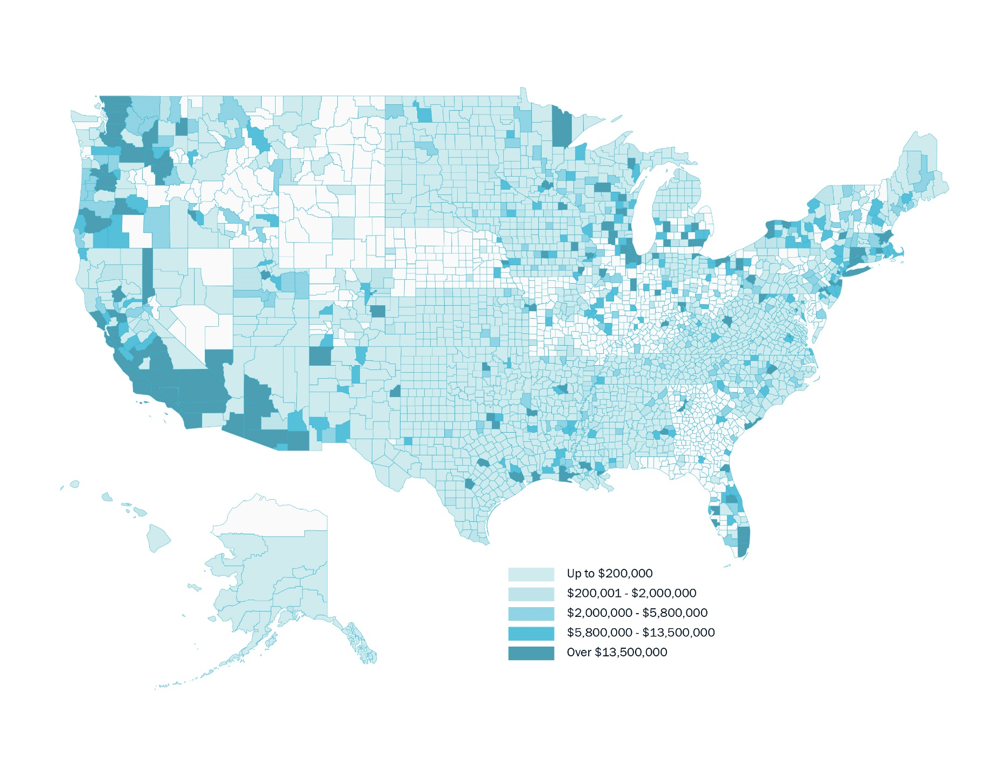
For Investors Creating an Impact Fund with LISC
01
Expertise:
A strong 40 year track record
Investment Execution
For every $1 LISC invests, $3 is leveraged from private
Access to Pipeline:
$100MM in projects
Protection of Principal
A focus on yield investments
02
Investments by US county
03
04

Slide 11
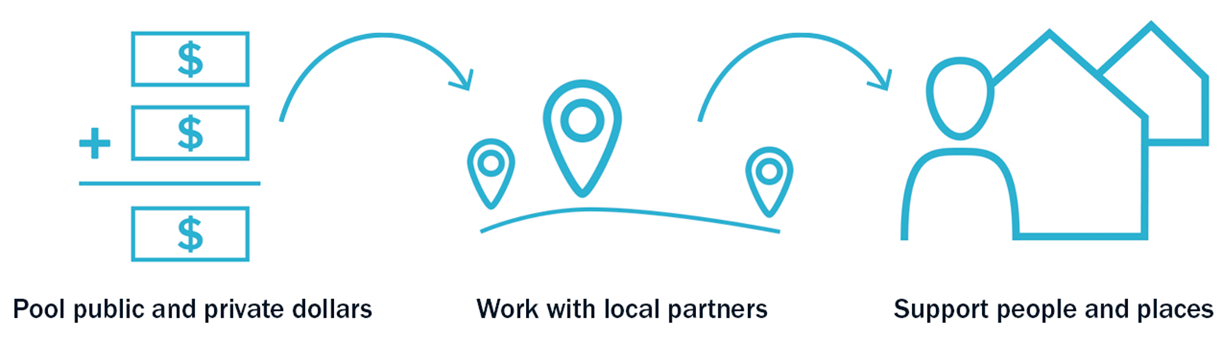
For Developers Why partner with LISC

Slide 12
For Local Stakeholders
Our Vision

Slide 13
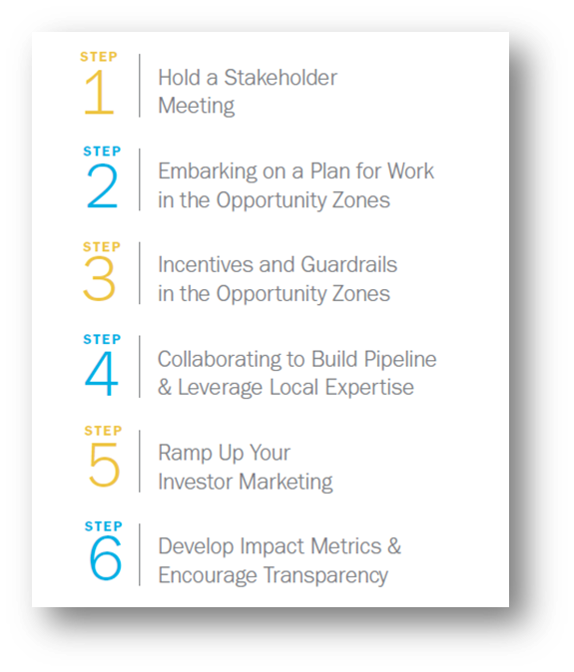
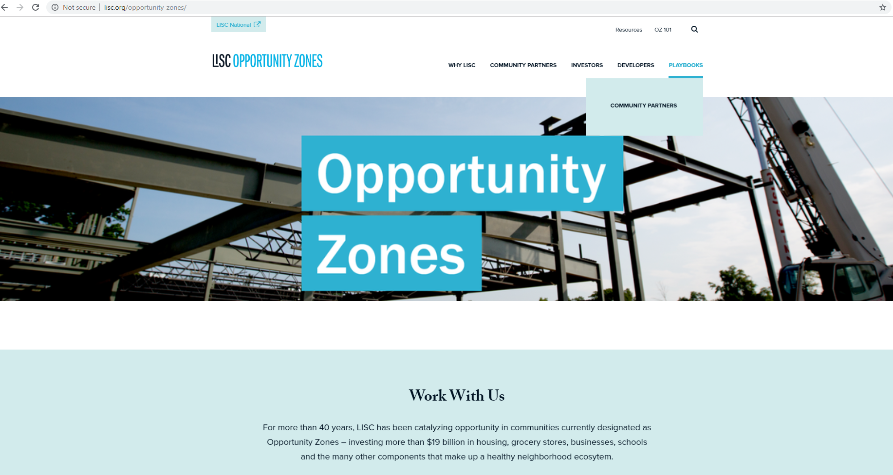
For Local Stakeholders Knowledge Leadership Online Resources
Download the “how-to” guide for stakeholders ready to engage in opportunity zone projects in their community.
02
01
Visit: LISC.ORG/OPPORTUNITYZONES
03
Subscribe to connect with our team

Slide 14
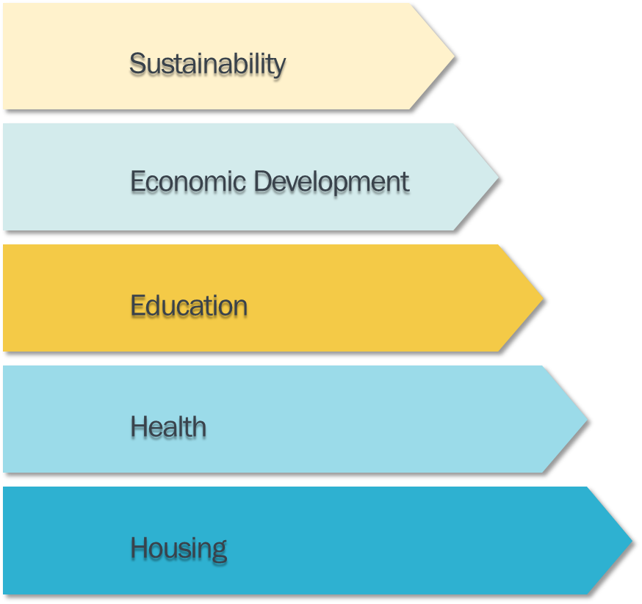
IMPACT FRAMEWORK Economic Opportunity for Underserved Communities
1
Smart Investments
Brings the right mix of development to support the long term stable economic growth of a community, avoiding overbuild and development bubbles.
2
Inclusive Investments
Ensure that all income levels within these communities will benefit from the economic progress created by the investments in these communities.
3
Impactful Investments
Offer specific advantages to underserved populations, with the assumption that market forces typically cater to the needs of well-served populations.

Slide 15
Opportunity Zones Housing Examples
Pairing w/ LIHTC or HTC
Tax credit investments providing housing for families at or under 60% AMI
15 year investment period
Investors = corporate investors with capital gains to invest and tax credit appetite (may be a limited investor market)
Workforce Housing
Providing housing for families at 80 – 120% AMI (Middle Income Housing that is needed in many communities)
10 year investment period
Investors = individuals or corporations
Lease-to-Own Housing
Single family or multi-family
Investors = social impact focus
Requires ability to revolve ozone equity capital

Slide 16
Opportunity Zones Economic Development Examples
Enhancement For Other Federal Tax Credit Transactions:
Business Infrastructure Real Estate Funds:
Venture Capital Funds:
Operating Business Private Equity:
Industrial
Retail
Mixed use
TOD
Seed stage investments
Series A investments
Businesses moving to or expanding in an Opportunity Zone
Equipment financing
NMTCs
Historic Tax Credits

Slide 17
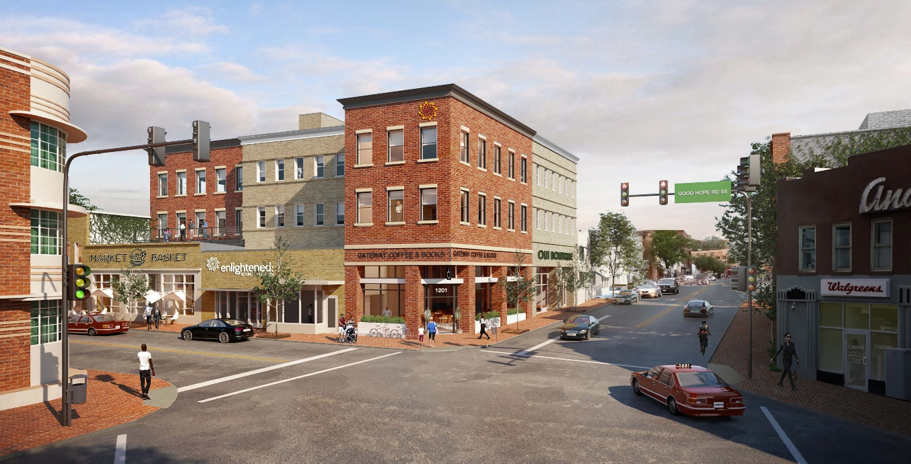
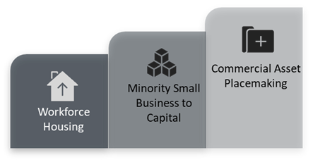
Local Fund Project MLK Gateway I & II Washington, D.C.
MLK Gateway, a $23 million, 44,000 SF commercial development sitting at the epicenter of main street Anacostia neighborhood. The project will be anchored by an award-winning minority owned IT & management consulting firm, Enlightened, employing over 150 residents--becoming the area’s largest private employment center and tech incubator for local minority-led startups.
$45MM
INVESTED
LOCALLY
$1.7MM
INITIAL EQUITY
272
NEW JOBS
$12 MM
IN ANNUAL
WAGES
THROUHG LISC’s INCLUSION INITIATIVE
INVESTED IN PROJECT PRE-DEVELOPMENT
CREATED BY MLK PROJECT
GENERATED THROUGH JOB CREATION
Terms
Project Sources | Amount
Bank Debt | $13.0 MM
Subordinate Debt | $1.0 MM
NMTC Equity | $5.0 MM
Opportunity Fund Equity | $3.0 MM
Sponsor Equity | $1.0 MM
Total | $23.0 MM
SE WASHINGTON DC AERIAL VIEW

Slide 18
National Initiative Seed Funding for Real Estate & Small Business
Washington
Newark
Atlanta
District of Columbia
New Jersey
Georgia
St. Louis
Dallas
Oakland
Missouri
Texas
California

