Slide 1
Anchor Partnerships are Building Healthy Places July 10, 2019

Slide 2
Annual Platinum Sponsor

Slide 3
Annual Sponsors
Annual Gold Sponsor

Slide 4
Annual Silver Sponsors
Lasberg Construction Associates
McLaren Engineering
Newmark Knight Frank
Northmarq Capital Markets
Perkins Eastman
RXR
Stewart Title
VHB
AKRF
Collins Enterprises
Cuddy & Feder
Divney Strategic Advisors
Hocherman Tortorella & Wekstein
JMC
Kimley-Horn
Langan Engineering & Environmental Services

Slide 5
Annual & Event Sponsorship Opportunities Currently Available Contact mara.winokur@uli.org for details

Slide 6
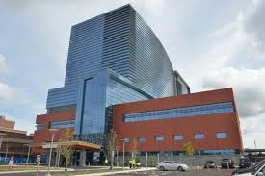
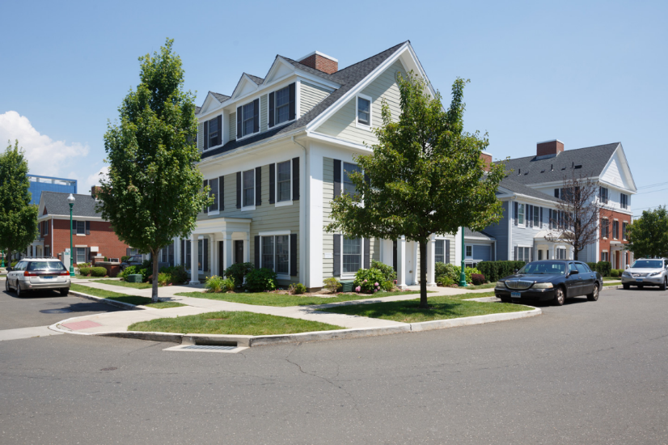
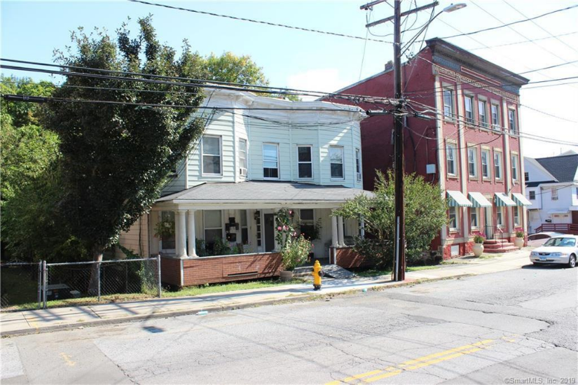
Welcome to Stamford’s West Side

Slide 7
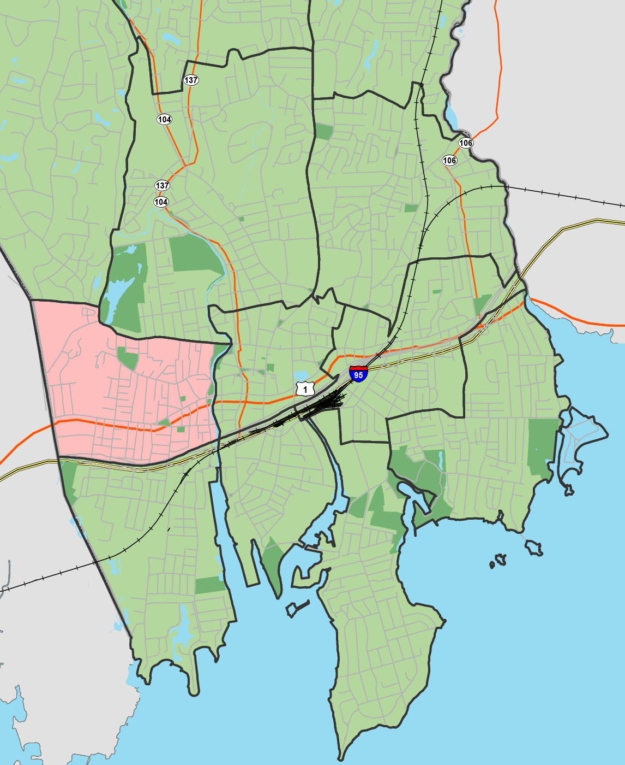
CONNECTICUT
NEW YORK
Fairfield County
Westchester
County
STAMFORD
Darien
Stamford
Glenbrook
Ridgeway
Bulls Head
STAMFORD
Long Island
New York City
Downtown
East Side
West Side
Cove
South End
Waterside
Greenwich
Shippan
Long Island Sound

Slide 8
West Side Demographics
 | West Side | Stamford
Race / Ethnicity
White alone | 33.6% | 60.9%
Black alone | 28.7% | 14.6%
Asian alone | 3.5% | 8.8%
All other / two or more | 34.2% | 15.7%
Hispanic | 46.6% | 26%
Pop over 25 with BA | 15.4% | 47%
Pop over 5 with limited English proficiency | 32.8% | 18.5%
Renter occupied | 69.6% | 44.2%
Households receiving Food Stamps | 30% | 8.9%

Slide 9
West Side Plans
West Side Transportation Study
West Side Neighborhood Plan

Slide 10
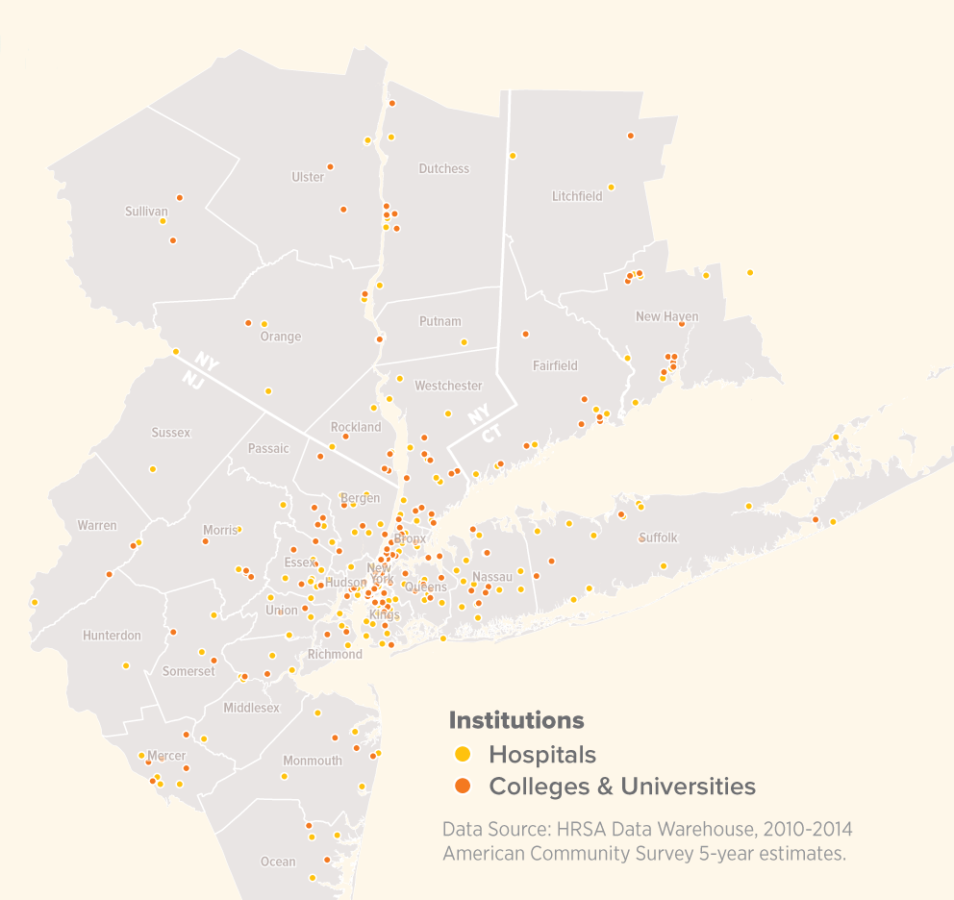
Anchor Opportunity Network NY-NJ-CT
ULI Westchester/Fairfield &
Northern New Jersey
Melissa Kaplan-Macey, AICP
Vice President, State Programs &
Connecticut Director, RPA
Vincent Tufo
Executive Director, Dovetail
CEO, Charter Oak Communities
Pamela Koprowski
Principal, Cardinale Associates
July 10, 2019
Notes:
I’m sure you all have a lot of questions about what this is and why you’re here
We have a lot of questions too and are starting to figure out the answers
We’re so excited that you’re hear to engage in this conversation
We think we’re onto something and want to know what you think about it

Slide 11
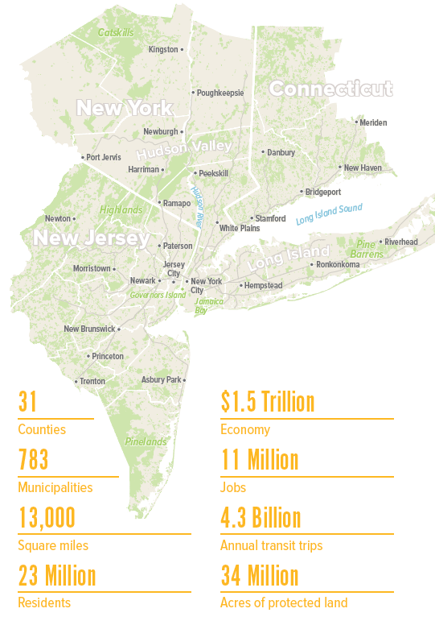
Regional Plan Association
Non-profit research, planning and advocacy organization dedicated to improving the New York metropolitan region’s economic health, environmental sustainability and quality of life for nearly a century.
2 Million

Slide 12
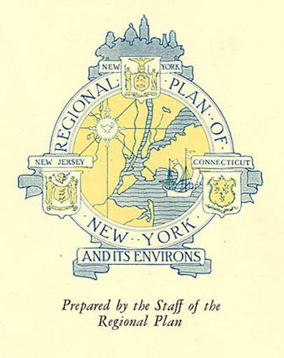
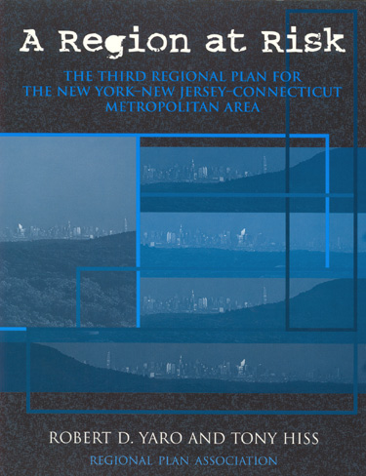
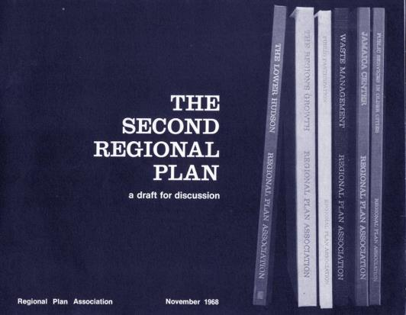
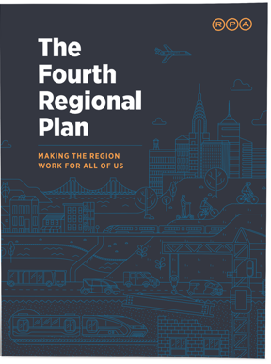
WHAT WE DO
Since 1922, Regional Plan Association has prepared four long range plans for the
tri-state metropolitan region
Notes:
For nearly 100 years RPA we have developed long-range plans to guide the growth of the New York metropolitan area.
Our plans are shaped by in-house team of planners, researchers, and writers in collaboration with civic groups, private sector, public sector and academia.

Slide 13
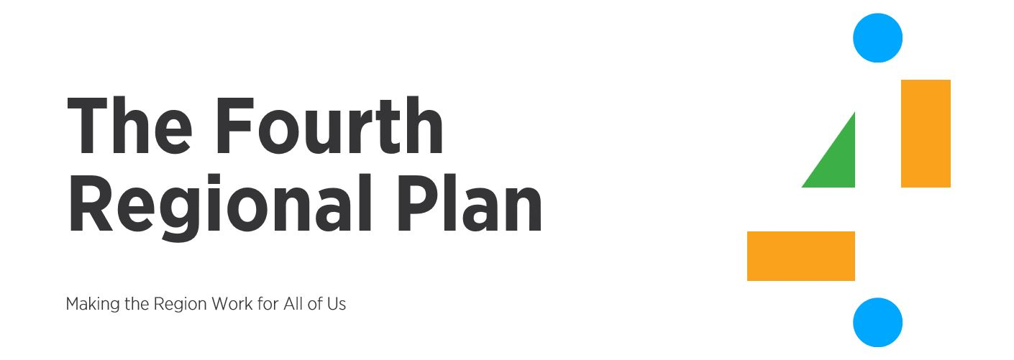
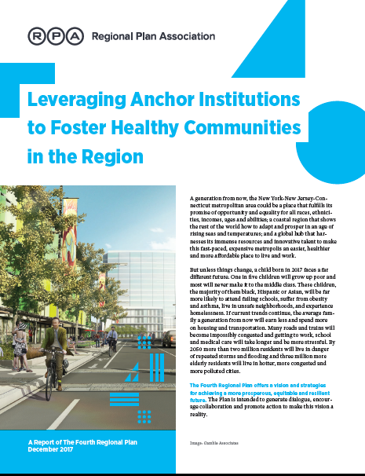
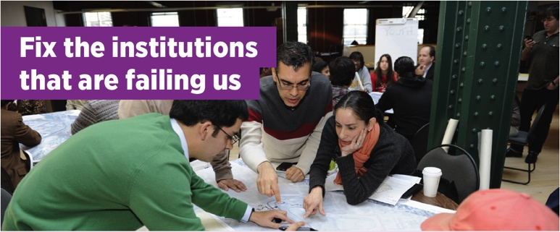
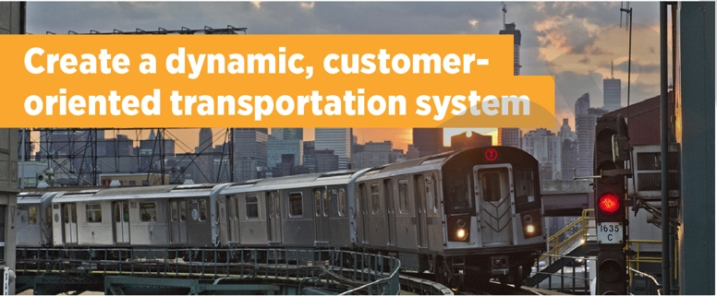
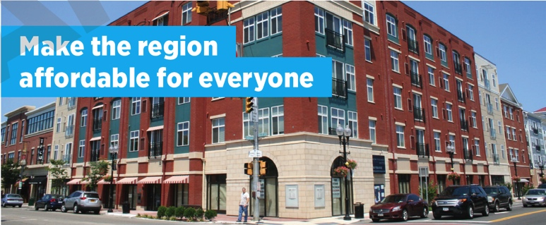

Slide 14
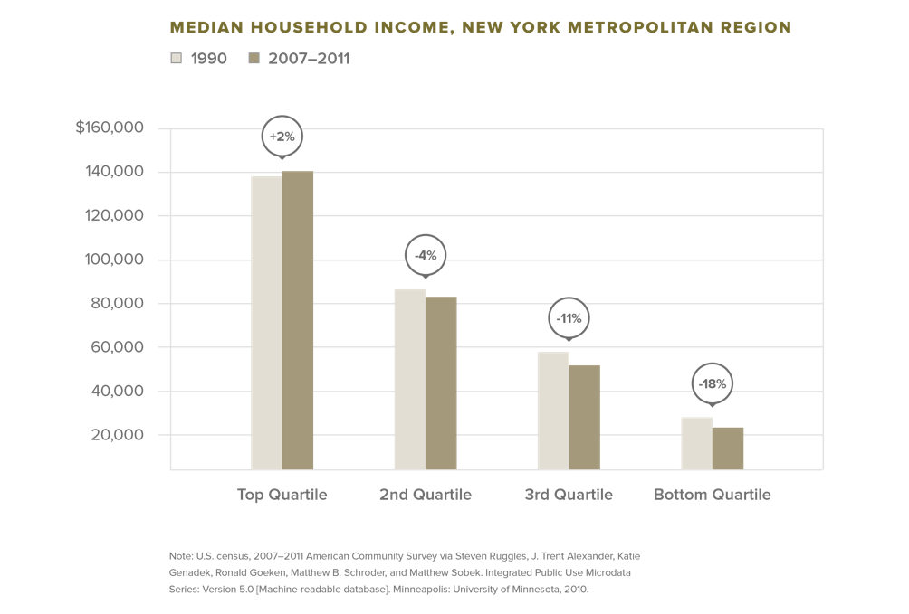
Median incomes have dropped since 1990 for more than three- quarters of the region’s households

Slide 15
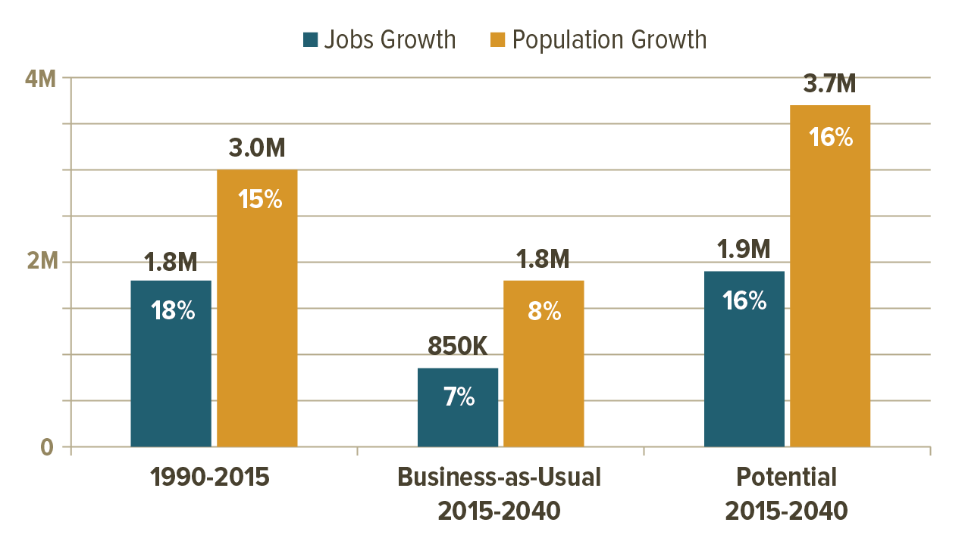
Population & Job Growth
Notes:
And jobs and population across the region grew by 18 & 15% respectively over the past 25 years, looking forward we can expect half that growth if we continue to do business the way we always have.

Slide 16
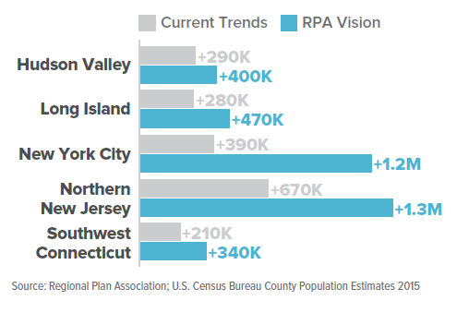
Population Growth Current Trends & Fourth Plan Vision

Slide 17
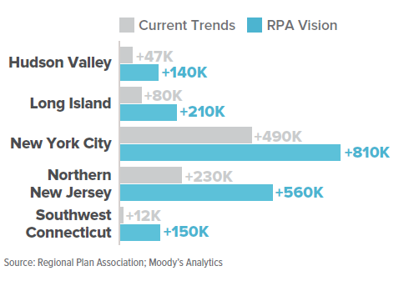
Job Growth Current Trends & Fourth Plan Vision

Slide 18
More than 340 health care & higher education institutions in our region

Slide 19
What is an anchor institution?
Often largest employers in their communities
Mission based, non-profit & public institutions
Locally Rooted
Vested stake in local community
Historically tied to place
Major land holdings and capital investments
Significant purchasing power
Notes:
Let’s start at the beginning- what is an anchor institution?
Show of hands, who in room is representing an anchor institution?

Slide 20
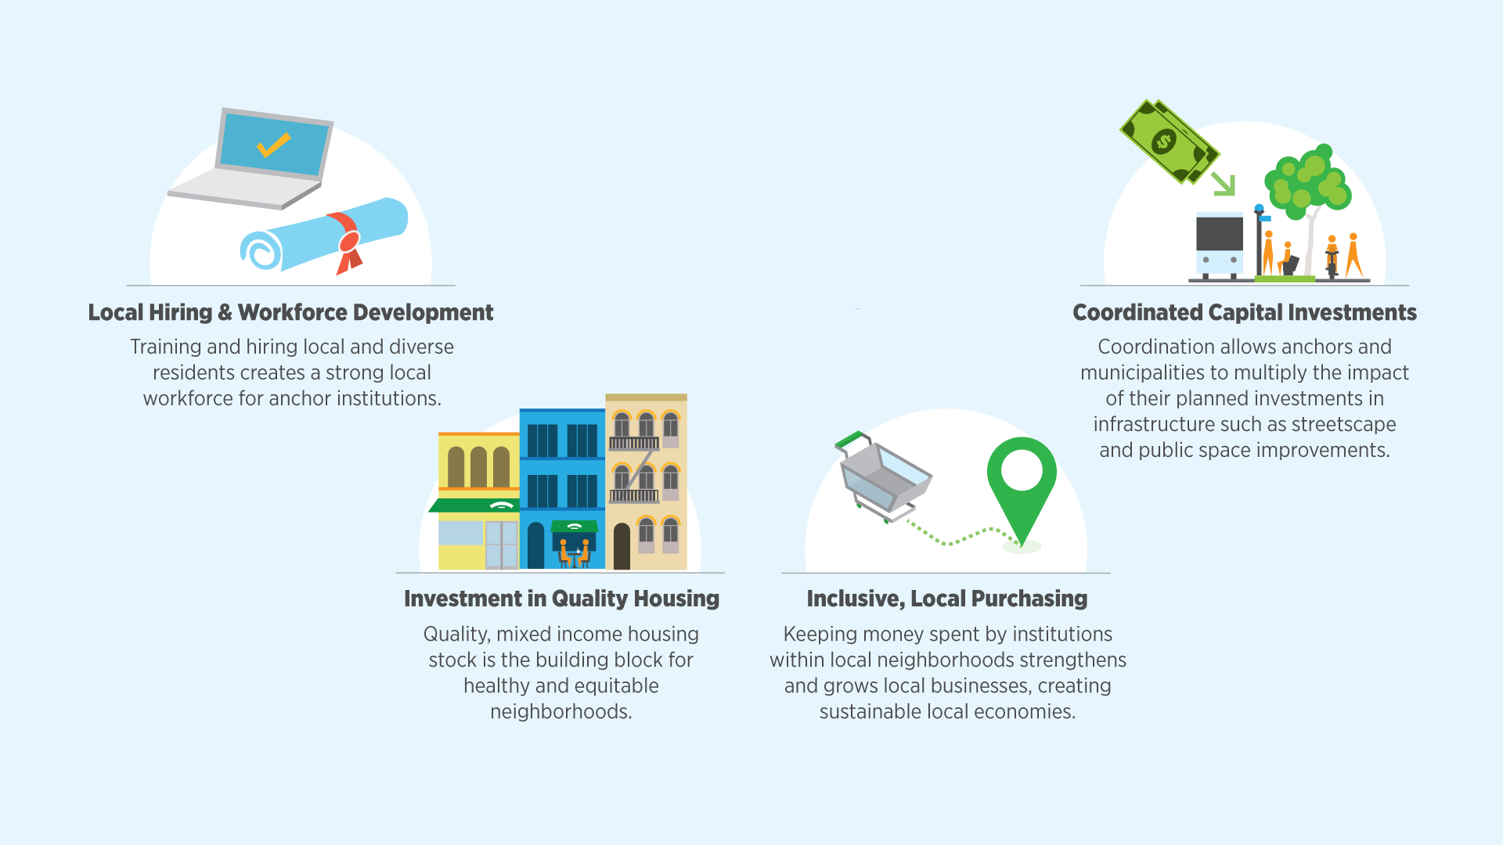
Equitable Economic Growth

Slide 21
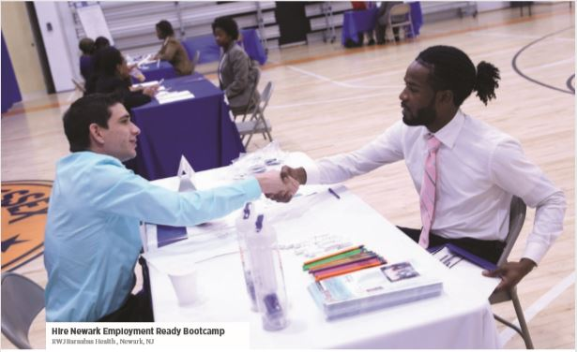

Slide 22
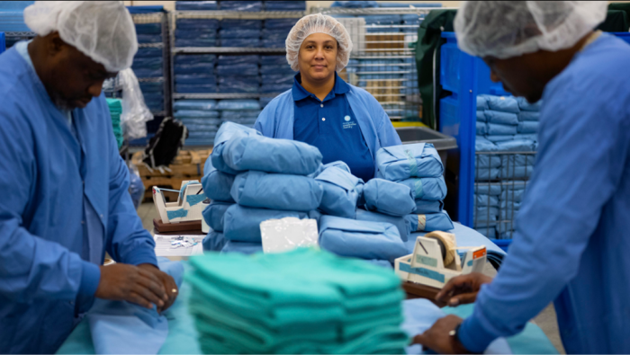

Slide 23
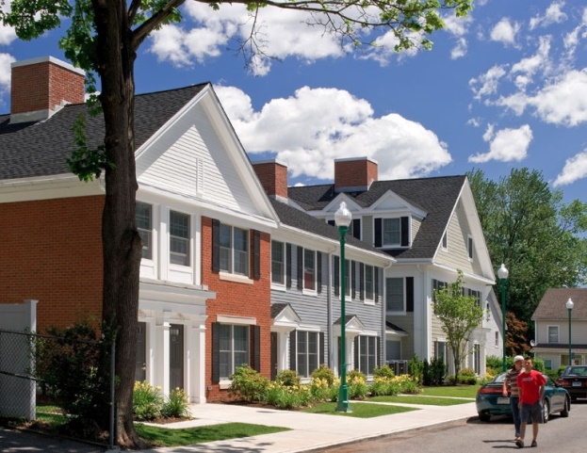
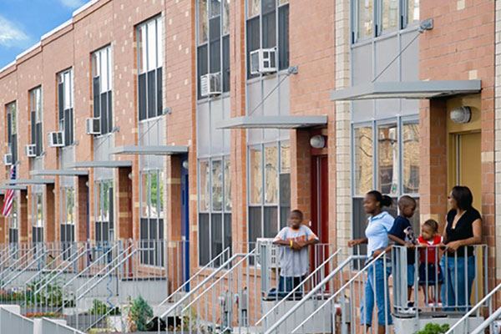

Slide 24
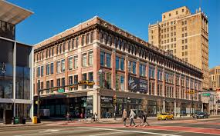
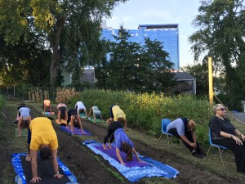
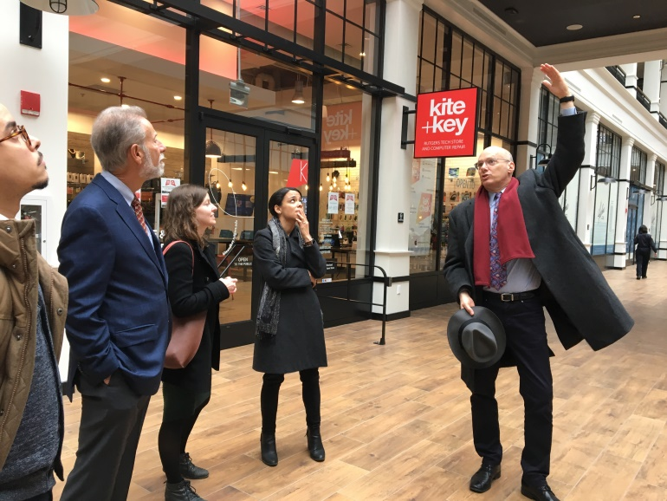

Slide 25
Why doesn’t it happen more?
Large institutions have been historically inward facing
Many are physically & functionally disconnected from surrounding neighborhoods
Business functions are operationally detached from institutional mission
Lack of formal mechanisms for collaboration with municipalities and communities
Notes:
Result of this is physical, economic and social disinvestment in neighborhoods surrounding these institutions

Slide 26
Notes:
The AON will engage with anchor institutions, municipal leaders and local communities to create meaningful and sustainable partnerships that leverage diverse capital and human resources to drive community well-being and equitable economic growth.

Slide 27
Supporting Local Partnerships
Unlock human & financial resources within and across partners to power investment
Providing technical assistance to help members implement & grow anchor collaborations
Helping to align anchor, public & private investments
Engaging members in anchor, municipal & neighborhood planning efforts

Slide 28
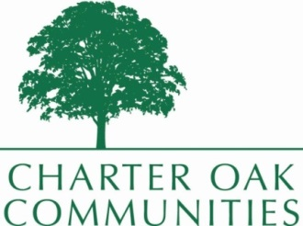
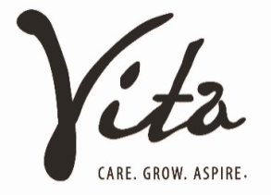
What does a successful anchor partnership look like in our region?

Slide 29
Alignment for Partnership
Stamford Hospital
Evaluated its 50-year facilities and service outlook
Identified need for facility replacement and campus modernization
Charter Oak Communities
Evaluated the long range outlook and viability of conventional public housing
Determined to replace dense, aging public housing projects with attractive mixed income communities

Slide 30
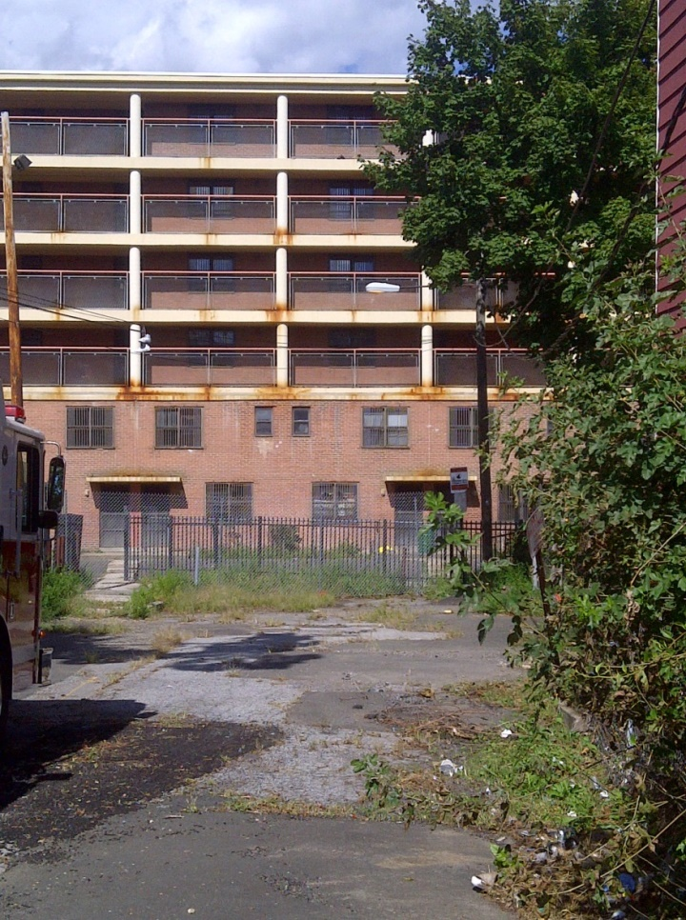
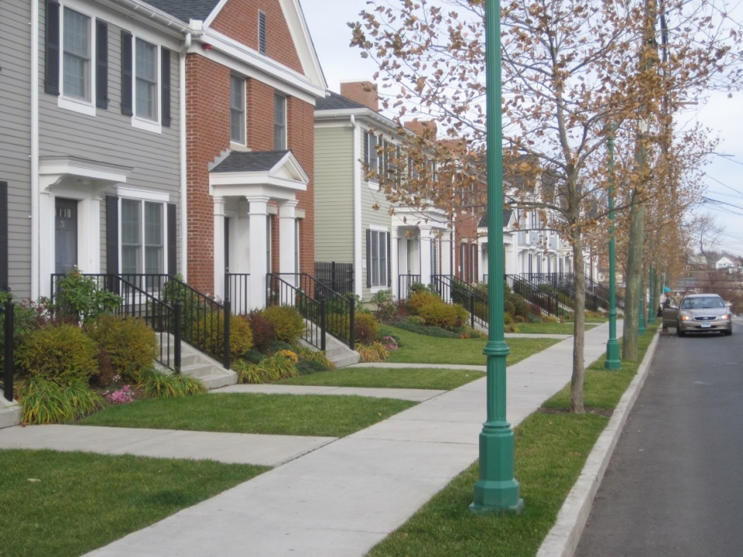
Neighborhood in Transition
Vidal Court public housing built in 1955, demolished 2013
Fairgate HOPE VI mixed- income community, built 2010

Slide 31
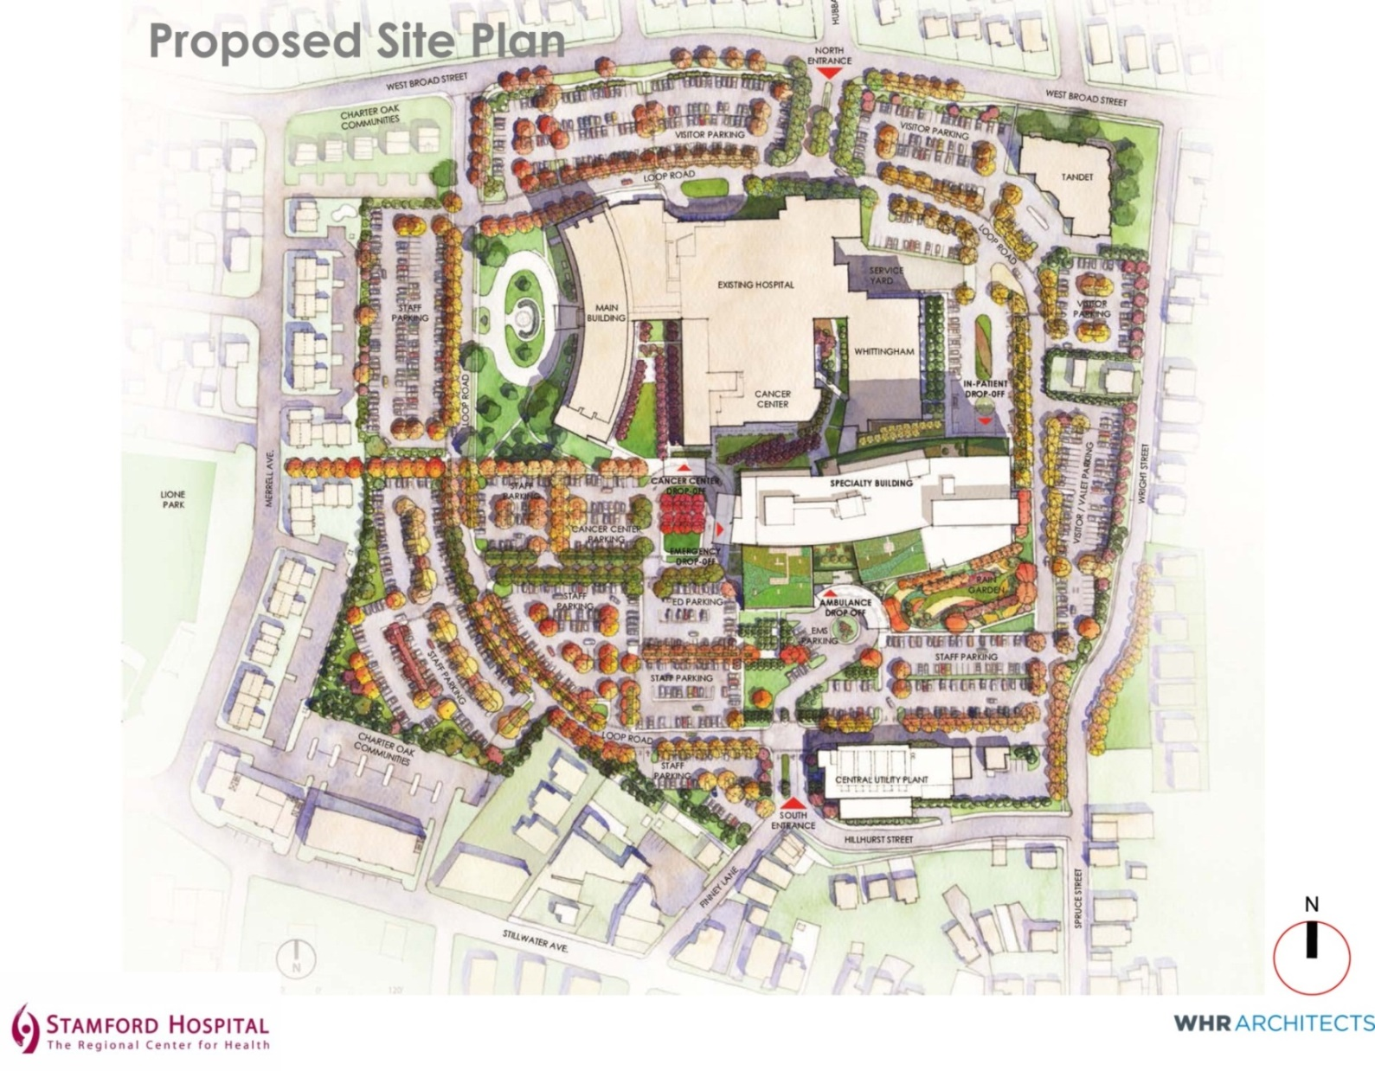
Hospital Expansion Plan

Slide 32
Outcomes: Improved Livability & New Hospital Facility
Quality of Life: Public-private investment in walk-able neighborhood, aligned with improvement in parks and streetscape; reductions in crime and nuisance conditions
Hospital Replacement: New $500M state of the art hospital with improved physical connections to the community

Slide 33
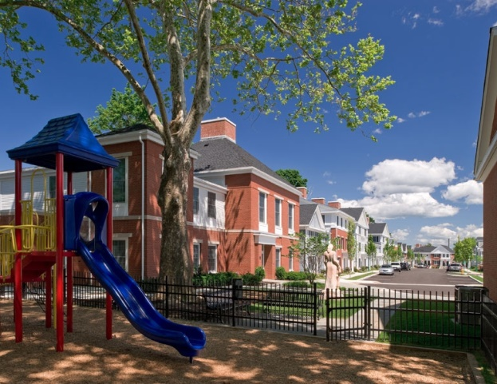
New Housing & Economic Development
Housing: Created 550 units of attractive, mixed-income, healthy housing with on-site support services
Business Development: Attracted new businesses, community facilities and activated WSNRZ Merchants Association

Slide 34
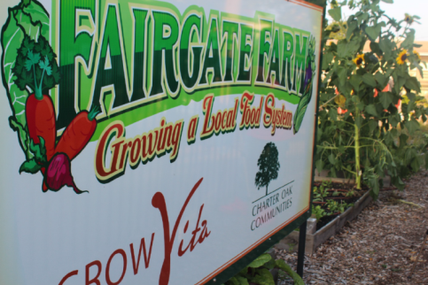
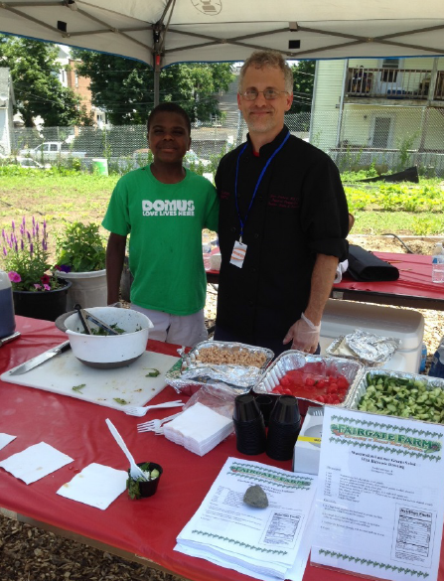
Healthy Nutrition & Community Building
Access to Healthy Food: Established Fairgate Farm community garden and nutrition education center supported by programs, volunteers, farmers market and cooking classes
Obesity Prevention: Kids’ Fitness & Nutrition Services (KidsFANS), a community-wide taskforce for the prevention of childhood obesity has served thousands of children

Slide 35
Anchor Partnerships Building Healthy Places
Questions…
Please join our walking tour

